Slide 1
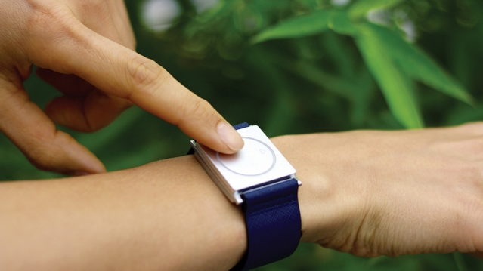
Field Study of a Tactile Sound Awareness Device for Deaf and Hard of Hearing Users
Dhruv “DJ” Jain, Brendon Chiu, Steven Goodman, Chris Schmandt, Leah Findlater, Jon E. Froehlich
Please turn on subtitles if you haven’t :)

Slide 2
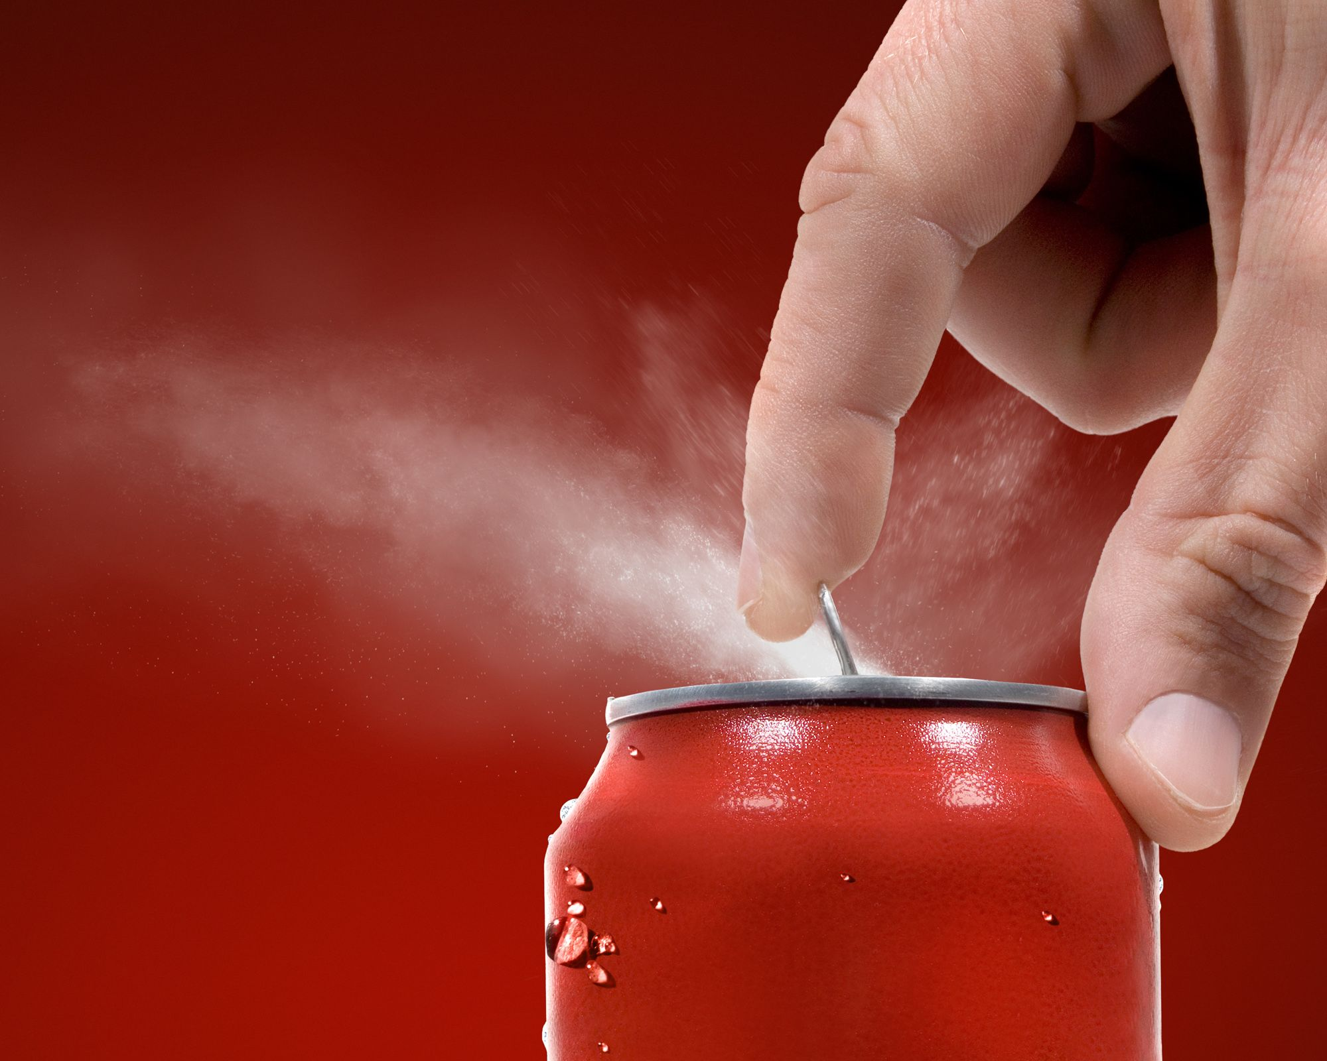
The world is filled with a
rich diversity of sounds

Slide 3
In many situations, however, sound is inaccessible to
people who are deaf or hard of hearing (DHH).

Slide 4
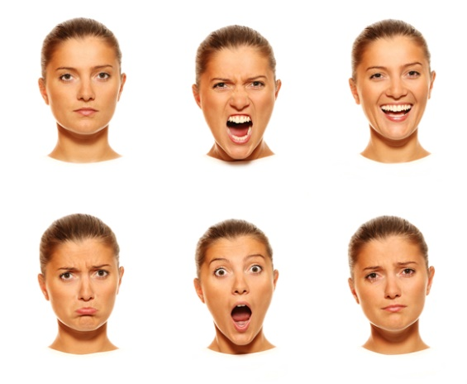
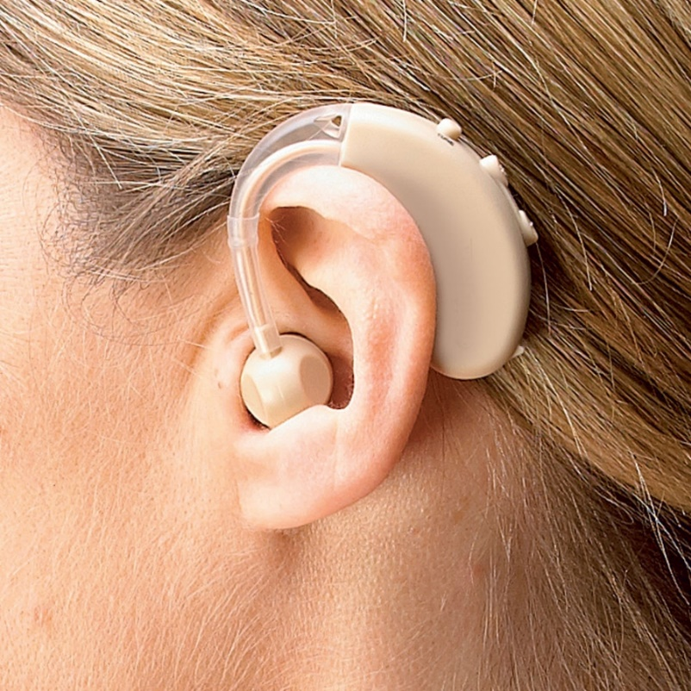
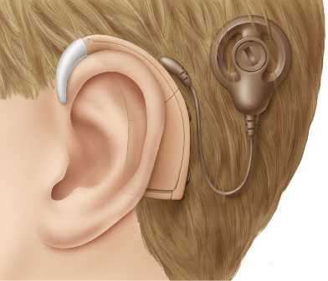
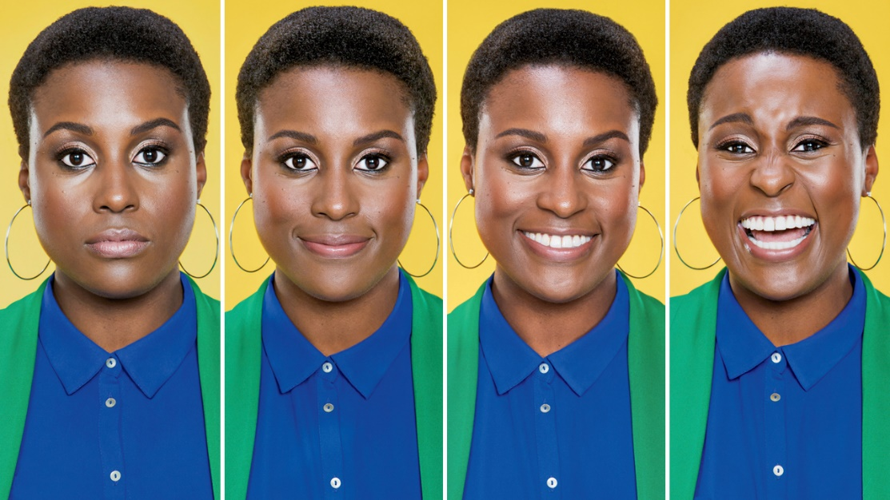
Hearing Aid
and
Cochlear Implant
are not suitable for all hearing ranges…

Slide 5
We explored a complementary approach:
tactile-based sound awareness

Slide 6
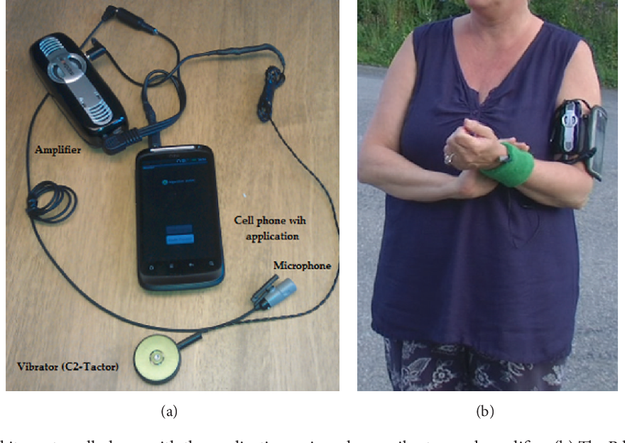
Most prior studies on tactile feedback with DHH
users was conducted over 20 years ago...

Slide 7
The perceptions of wearable devices and the cultural
norms of DHH people have changed a lot in 20 years.

Slide 8
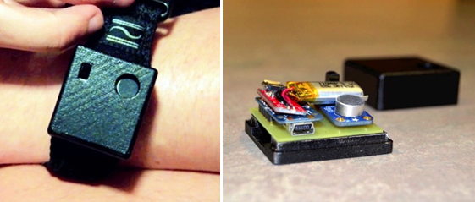
Vibes
A 2in x 2in wrist-worn device
Vibration intensity is proportional to the loudness of the sound

Slide 9
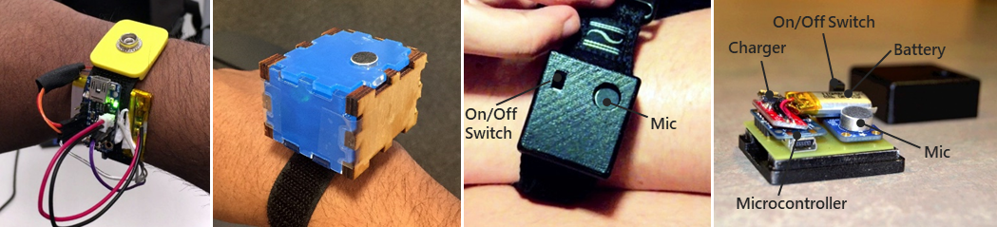
A four-week field study with DHH 12 users...
Vibes

Slide 10
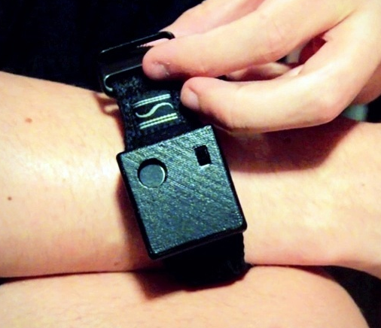
Findings
Vibes was used for any required actions, but also for ’experiential’ purposes

Slide 11

“I do bird photography. So, when I was walking in the woods, the device started vibrating [in patterns] like the bird calls. That gives me some indication of how a bird call might sound. Makes me closer to the nature…”
- P3

Slide 12
Findings
Vibes was used for any required actions, but also for ’experiential’ purposes

Slide 13
Findings
Vibes was used for any required actions, but also for ’experiential’ purposes
Some participants became more conscious about their own activities that produce sounds

Slide 14
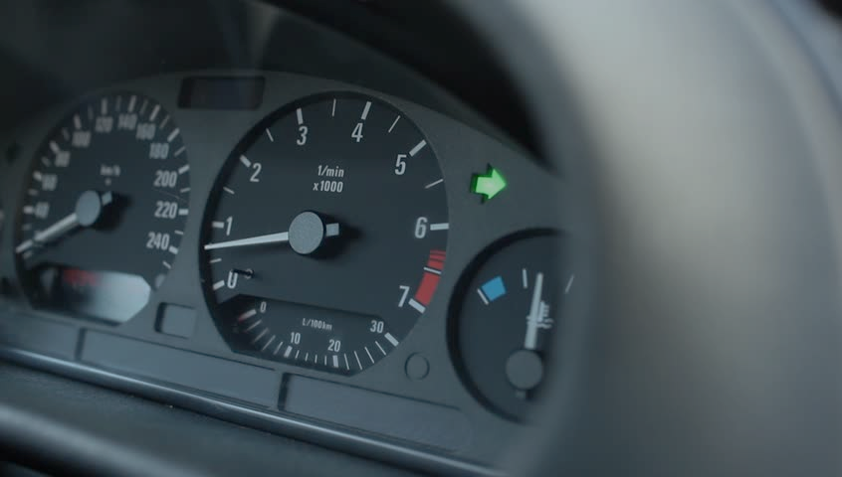
“I sometimes leave my car indicator light on as I can’t hear. This usually happens after I take a very short turn and the light doesn’t go off. Now with the device, I know when to turn it off.”
- P6

Slide 15
Findings
Vibes was used for any required actions, but also for ’experiential’ purposes
Some participants became more conscious about their own activities that produce sounds

Slide 16
Findings
Vibes was used for any required actions, but also for ’experiential’ purposes
Some participants became more conscious about their own activities that produce sounds
Four participants stopped using the device at home

Slide 17

“it provided very little information and I know what [is] going on around my home”.
- P12

Slide 18

Reflection

Slide 19
Sound helps hearing people feel immersed and present in the world.
Future work should continue to examine ways for providing experiential cues to DHH people.

