Slide 1
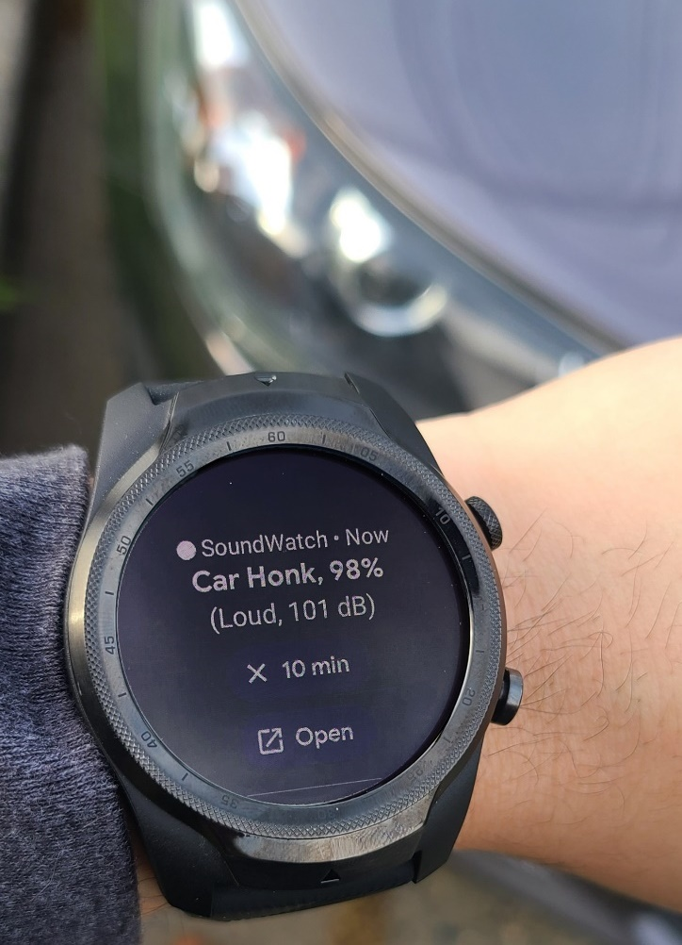
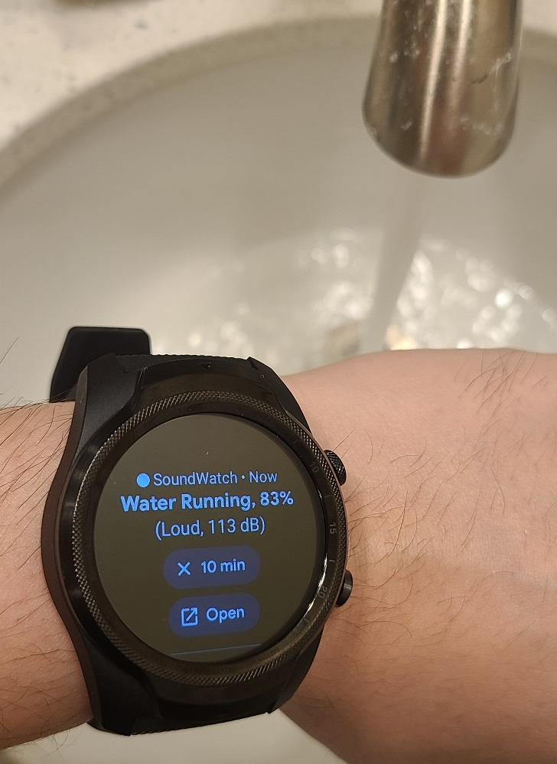
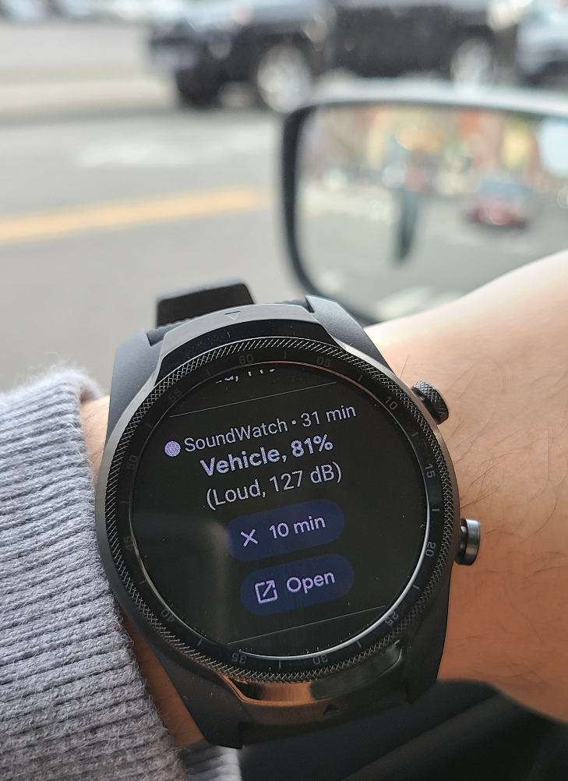
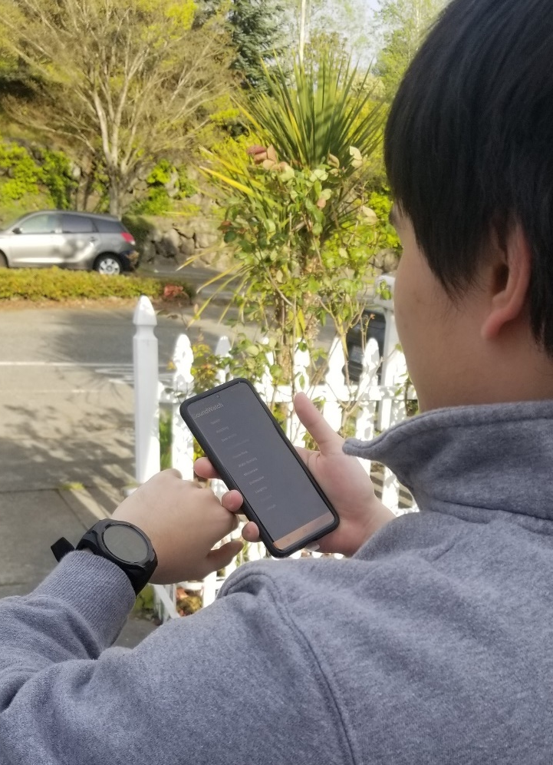
Exploring Smartwatch-based Deep Learning Approaches To
Support Sound Awareness for Deaf and Hard of Hearing Users
Dhruv Jain, Hung Ngo, Pratyush Patel, Steven Goodman, Leah Findlater, Jon Froehlich
ASSETS 2020 Paper
Notes:
Hi. I am DJ, presenting my work that we submitted to the ASSETS conference this year. It’s on Smartwatch-based Deep Learning Approaches for Sound Awareness. Let me start with a brief motivation.

Slide 2
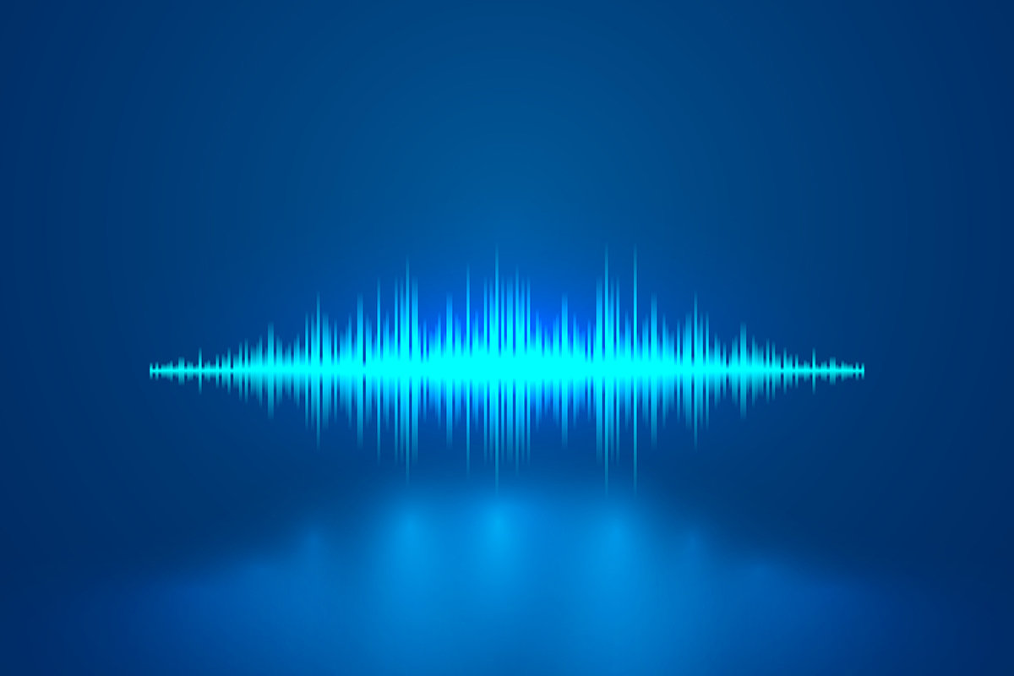
Sound recognition is at the heart of many modern AI systems.
Notes:
Sound recognition is at the heart of many modern AI systems used for home surveillance, appliance repairs, and accessibility.

Slide 3
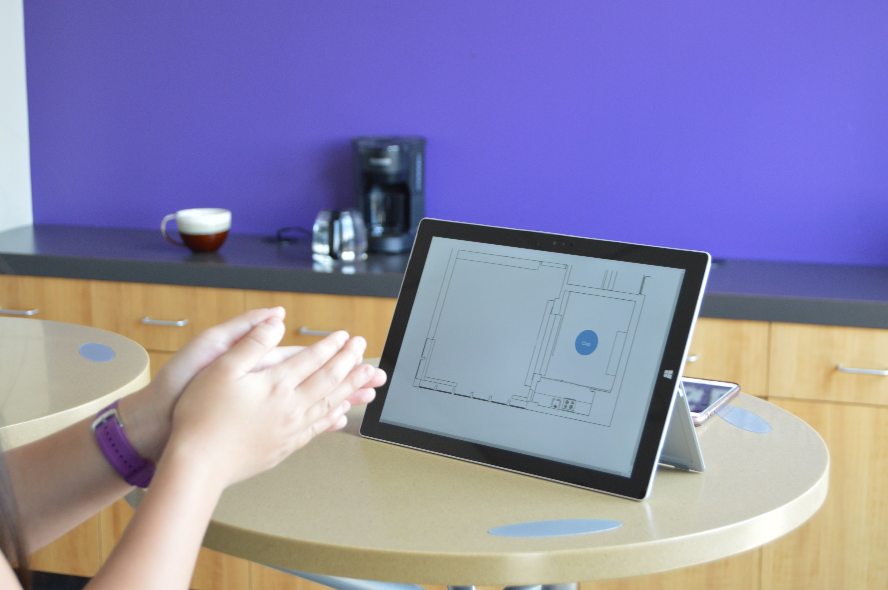
Our past work examined sound recognition to support d/Deaf and hard of hearing (DHH) users in the home.
However, the sensing and classification was done on non-portable devices.
Jain et al., HomeSound, CHI 2020
Notes:
For example, our own past work, HomeSound, investigated sound classification for accessibility, that is, to support DHH users in the home.
However, while the watch was used as a feedback device, as with most prior work, the sensing and classification was done on non-portable devices.
With the recent shift in AI towards mobile-optimized models, it makes sense to explore sound classification for mobile and wearable devices.

Slide 4
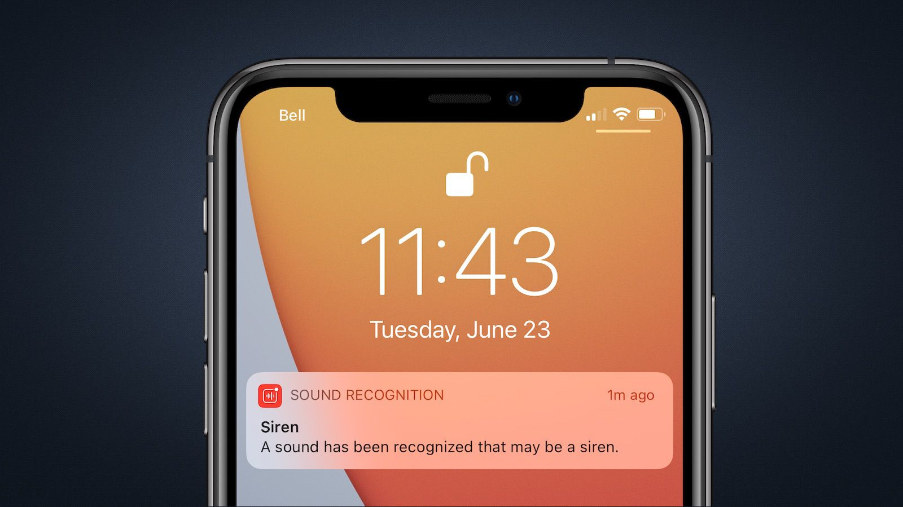
Recent iOS 14 update introduced sound recognition in consumer smartphones.
But this release is closed-source and the implementation details are unknown.
Notes:
Indeed, the recently release iOS 14 has incorporated sound recognition into consumer smartphones.
But this release is closed source and the implementation and evaluation details are unknown.

Slide 5
Two Studies
Study 1
A quantitative examination of four lightweight deep-learning models to classify sounds.
A qualitative evaluation of a smartwatch-based sound awareness app with 8 DHH participants.
Study 2
Notes:
In this work, we performed two studies:
a quantitative examination of four lightweight deep learning models to classify sounds on low-resource devices, and
a qualitative evaluation of a smartwatch-based sound awareness app, called SoundWatch, with eight DHH participants.

Slide 6
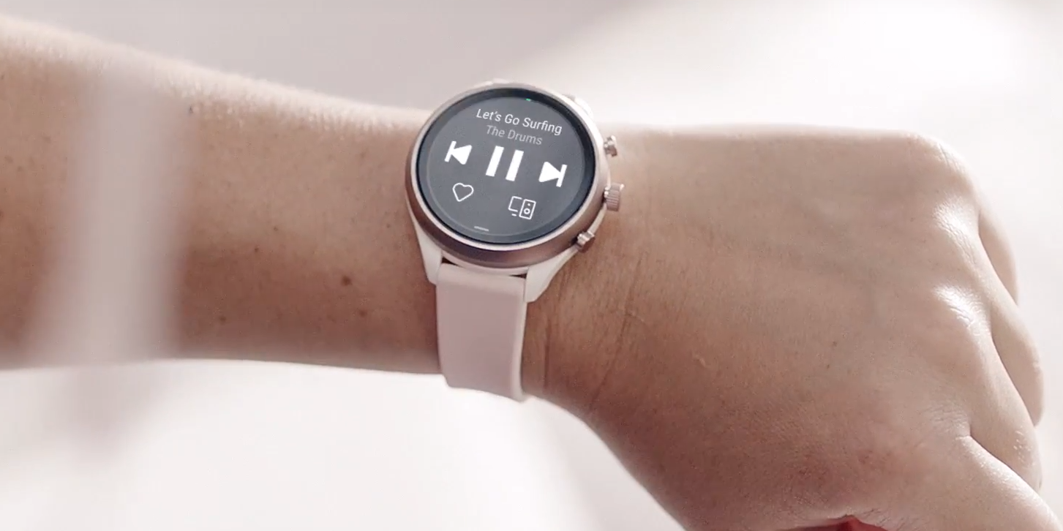
`
A recent study with 201 DHH users showed that smartwatch was the most preferred device for sound feedback.
Notes:
A recent study with 201 DHH users showed that smartwatch was the most preferred device—even more than smartphones—for sound feedback.

Slide 7
Two Studies
Study 1
A quantitative examination of four lightweight deep-learning models to classify sounds.
A qualitative evaluation of a smartwatch-based sound awareness app with 8 DHH participants.
Study 2
Notes:
Let’s go through each study in turn.

Slide 8
Two Studies
Study 1
A quantitative examination of four lightweight deep-learning models to classify sounds.
Notes:
Study 1

Slide 9
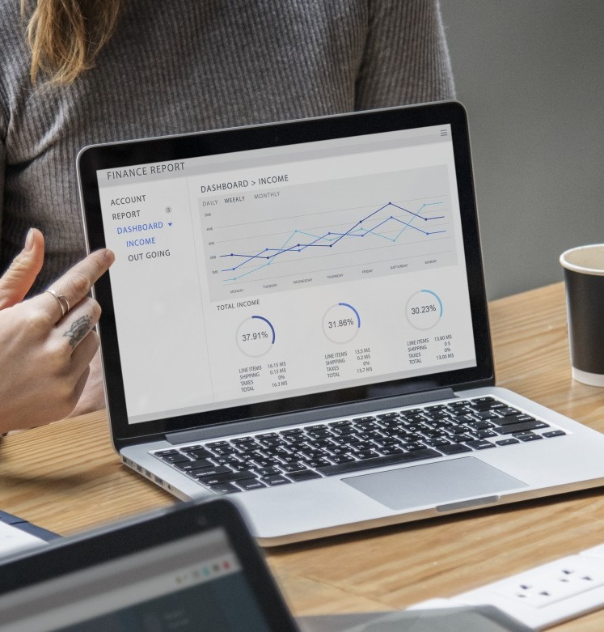
Study 1
Goal
Performance evaluation of four deep learning
sound classification models across four architectures.
Models
Three recently released TensorFlow-Lite models: MobileNet (3.4MB), Inception (41MB), ResNet-Lite (178.3MB) and a quantized version of our model: VGG-Lite (281.8MB).
Also, a comparison with state-of-the-art full-VGG model (845.5MB) running on a laptop.
Architectures
Watch-only, watch+phone, watch+cloud, and watch+phone+cloud.
A commercially available smartwatch (Tickwatch Pro) and smartphone (Honor 7x) were used.
Notes:
The goal of our first study was to conduct a performance evaluation of four-deep learning sound classification models across four device architectures.
We downloaded three lightweight image-classification models for small devices. These models were recently released in January 2020, and include: MobileNet, Inception, and ResNet-Lite. We also used a quantized version of the model from our HomeSound work which we call VGG-Lite.
To compare with prior approaches in sound classification, we compared our models with the full-VGG model for non-portable devices.
Four device architectures were examined: watch-only, watch+phone, watch+cloud, and watch+phone+cloud. For all our experiments, we used a commercially available smartwatch and smartphone.

Slide 10
Study 1 Findings
Goal
Models
Architectures
Notes:
Let’s quickly discuss what we found.

Slide 11
Study 1 Findings
Models
The best classification model (VGG-lite) had similar accuracy as the state-of-the-art for non-portable (VGG) but required substantially less memory (~1/3rd).
Accuracy of best model was 81.2% (SD=5.8%) for 20 sound classes and 97.6% (SD=1.7%) for three high-priority sounds, when evaluated on our dataset of field sound recordings..
Among our four models, we also observed a strict accuracy-latency trade-off: the most accurate model was also the slowest (avg. acc=81.2%, avg. latency=3.4s).
Notes:
While direct comparison to prior work is challenging, we found that the best classification model performed similarly to the state of the art for non-portable devices while requiring substantially less memory.
More specifically, the accuracy of our best model was 81.2% for all 20 sound classes and 97.6% for the three highest priority classes when evaluated on our dataset of sound recordings from the field.
Among our four models, we observed a strict accuracy-latency trade-off, that is, the most accurate model was also the slowest.

Slide 12
Study 1 Findings
Architectures
The two phone-based architectures (watch+phone, watch+phone+cloud) outperformed the watch-centric designs (watch-only, watch+cloud) in terms of CPU, memory, battery usage, and end-to-end latency.
Notes:
In terms of the architectures,
we found that the two phone-based architectures outperformed the watch-centric designs in terms of CPU, memory, battery usage, and the end-to-end latency.

Slide 13
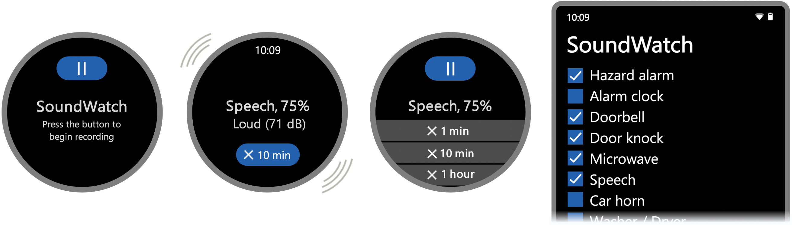
To complement these quantitative findings, we built and conducted a qualitative lab-evaluation of a smartwatch-based sound awareness app, called SoundWatch.
Notes:
To complement these quantitative experiments, we built and conducted a qualitative lab evaluation of a smartwatch-based sound awareness app, called SoundWatch, with eight DHH participants.
First, a brief description of SoundWatch.

Slide 14
SoundWatch
Time of occurrence
Sound identity
Loudness
Notes:
SoundWatch is an Android-based app designed for commercially available smartwatches that informs the users about three key sound properties: sound identity, loudness, and time of occurrence through customizable sound alerts using visual and vibrational feedback.

Slide 15
SoundWatch
Customizable sound alerts
Visual
+
Vibration
Notes:
SoundWatch is an Android-based app designed for commercially available smartwatches that informs the users about three key sound properties: sound identity, loudness, and time of occurrence through customizable sound alerts using visual and vibrational feedback.

Slide 16
SoundWatch
Support for four architectures with deep-learning model running on either watch (watch-only), phone (watch+phone), or cloud (watch+cloud, watch+phone+cloud).
Notes:
SoundWatch offers support for four device architectures with the deep learning-based model running on either the watch, the phone, or the cloud.

Slide 17
SoundWatch
SoundWatch processes the sound locally on the watch or phone and, in the case of the cloud-based architectures, only uploads non-reconstructable mel-spectrogram features.
Notes:
We designed our sensing pipeline to protect user privacy. [Slide] SoundWatch processes the sound locally on the watch or phone and, in the case of the cloud-based architectures, only uploads non-reconstructable mel-spectrogram features.
Now, let me describe its evaluation, that is, Study 2.

Slide 18

Study 2
Goal
Gather user feedback on our system results and the SoundWatch app.
Participants
Eight DHH participants (3 women, 3 men, 2 non-binary).
Method
Campus walkthrough with the SoundWatch app in three contexts: a lounge, a lab, and a bus stop.
Post-trial interview on the experience and other technical considerations—e.g., desired accuracy-latency tradeoff, thoughts on the four SoundWatch architectures.
Notes:
The goal of Study 2 was to gather user feedback on our system results and the SoundWatch app.
We recruited eight DHH participants: 3 women, 3 men, and 2 non-binary.
The procedure included a campus walkthrough with the SoundWatch app in three contexts: a lounge, a lab, and a bus stop.
After the walk, we performed an interview on the experience and other technical considerations such as the desired accuracy-latency tradeoff for deep-learning models, and thoughts related to privacy and resource consumption for the four possible architectures: watch-only, watch+phone, watch+cloud, watch+phone+cloud.

Slide 19




All participants generally appreciated SoundWatch across
all three contexts, reaffirming past sound awareness work.
Study 2 Findings
Notes:
We found that all participants generally appreciated SoundWatch across all three contexts, reaffirming past sound awareness work.

Slide 20



However, misclassifications were concerning,
especially outdoors due to background noise.
Study 2 Findings
Notes:
However, we also observed several misclassifications, especially outdoors due to background noise.

Slide 21
Participants wanted minimum delay for urgent sounds (e.g., car honk, water running)
and maximum accuracy for non-urgent sounds (e.g., speech, background noise).
Study 2 Findings
Notes:
For accuracy-latency tradeoffs, participants wanted minimum delay for urgent sounds such as a car honk in order for them to take any required action, and they wanted maximum accuracy for non-urgent sounds (e.g., speech) to not be unnecessarily disturbed.

Slide 22


Watch+phone was the preferred architecture because compared to the cloud-based design,
it was more private and versatile and compared to the watch-only, it was faster.
Study 2 Findings
Notes:
Finally, participants selected watch+phone as the most preferred architecture because compared to the cloud-based architectures, it was more private and versatile (no internet connection required), and compared to the watch-only, it was faster.

Slide 23

Reflection
Notes:
[Pause]

Slide 24
How well does a smartwatch-based
sound classification tool need to perform?
Needs further study…
Notes:
In reflection, we come back to our research question: “how well does a smartwatch-based sound classification tool need to perform to provide value?”
Our findings show that this is a complex question that needs further study.

Slide 25
Recommendations
1
Explore usage in the field.
But this introduces ethical and safety concerns.
Increasing transparency may help.
Explore showing multiple “possible” sounds.
Explore end-user customization.
Explore end-user interactive training of the model—e.g., Wu, CHI ’20.
But this may be tedious if the sound is inaccessible to DHH users.
2
3
4
Notes:
One way to explore is to release SoundWatch to the public, much like what Apple did with the iOS 14, and study the actual usage.
However, this approach also introduces ethical concerns (if the user’s private data is recorded) and also safety concerns, for example, if the app fails to recognize a critical sound such as a fire alarm.
But, increasing transparency by allowing the user to view their collected sound data and by letting them know that the app could fail at any point may help.
Another idea to increase the “perceived” accuracy is to explore showing multiple “possible” sounds. For example, if the system fails to differentiate between a microwave or a dishwasher, why not show the possibility of both instead of showing the most probable sound, as in our design.
We can also explore end-user customization. While installing the app, each user could select the desired sounds, and the app could dynamically fine-tune the model.
Finally, future work could give the option for the participants to train their own sounds, much like what Jason Wu and the team at CMU did for one-shot interactions.
Of course, this training may be tedious and difficult if the sound itself is inaccessible to DHH people.

Slide 26
Smartwatch offers a myriad of possibilities for DHH users and beyond.
Notes:
In conclusion, I’d like to say that, Smartwatch offers a myriad of possibilities for DHH users and beyond.

Slide 27
Please refer to the paper for more interesting
ideas on smartwatch + sound feedback.
Notes:
Please refer to the paper for more interesting ideas to explore on smartwatch and sound feedback.

