Slide 1
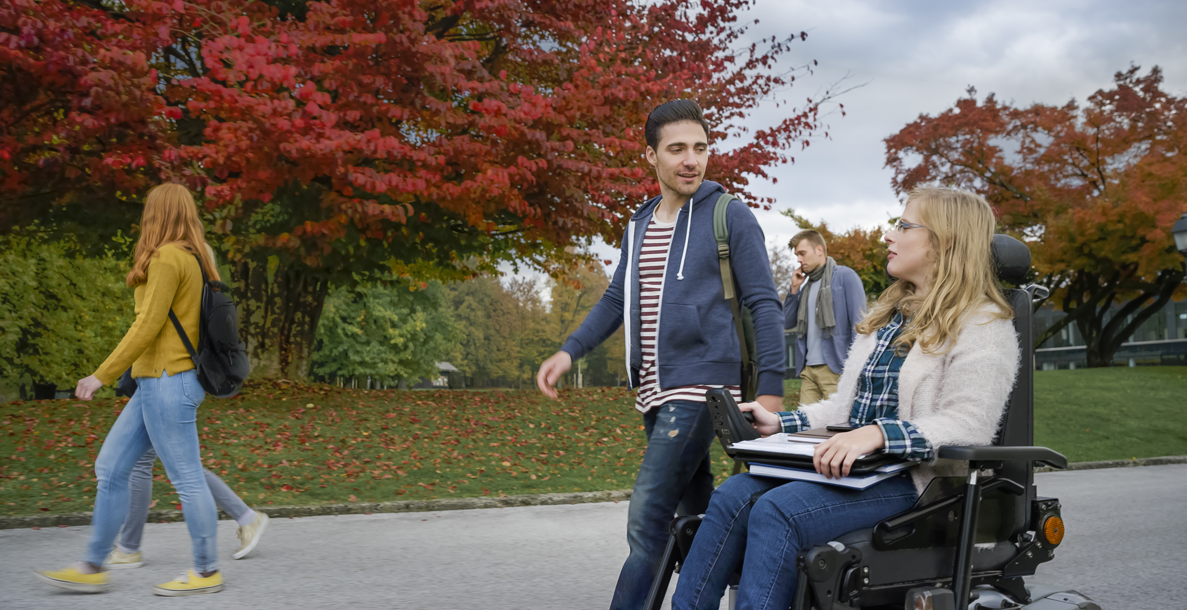
Navigating Graduate School with a Disability
Dhruv Jain, Venkatesh Potluri, Ather Sharif
University of Washington
bit.ly/navgrad
Notes:
Hi, I am DJ! I am excited to present our journey of Navigating Graduate School with a Disability.
Before I begin, just a note. I am hard of hearing and I have a Deaf accent. If you are not able to understand me, please just read through the slides. The slides contain text for everything that I am going to share with you today.
On another note, all images in this talk are decorative. So, let’s begin.
What is this talk about?

Slide 2
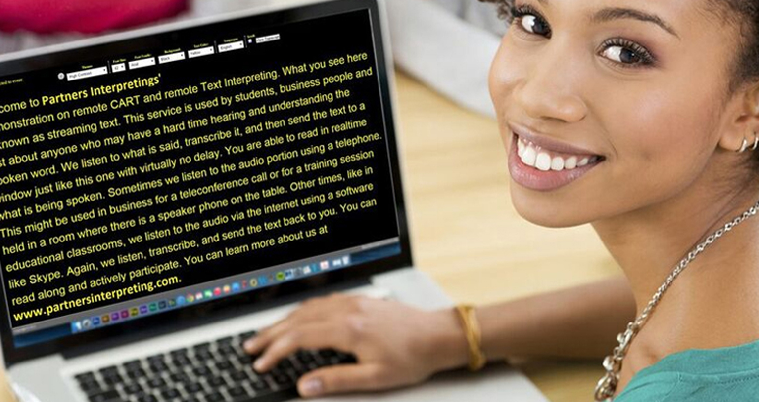
In graduate school, people with disabilities
use various disability accommodations
to learn, network, and do research.
Notes:
In graduate school, people with disabilities use disability accommodations such as real-time captioning and in-class scribes.

Slide 3
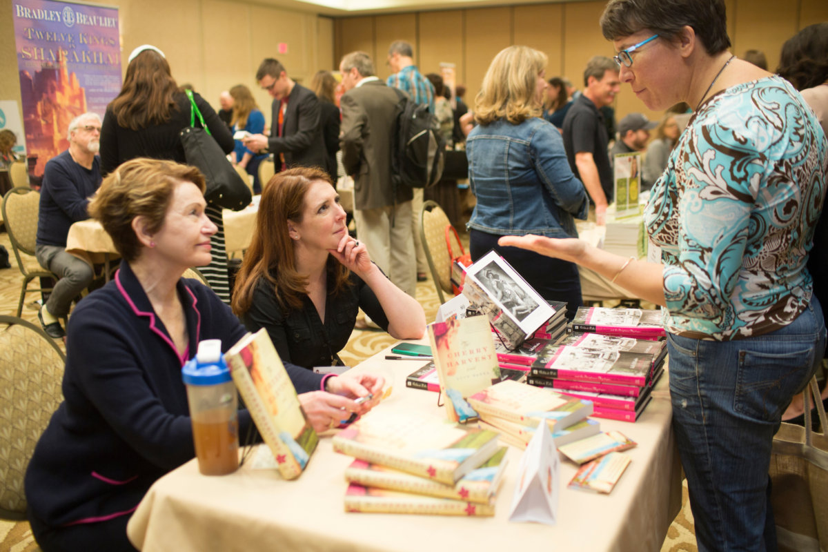
However, these pre-planned accommodations may not work in many situations.
Notes:
However, due to the unpredictability of the graduate school, there are many situations in which these pre-planned accommodations do not work.

Slide 4
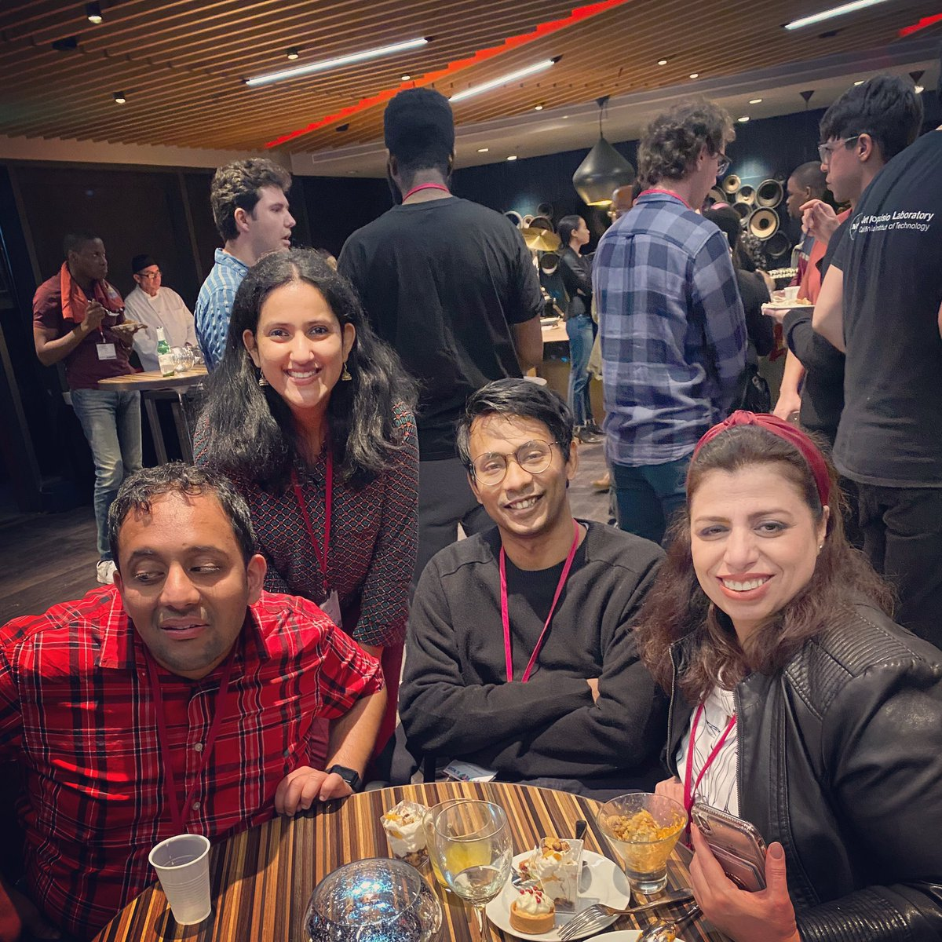
Through a trio-ethnography of three graduate students with disabilities,
we highlight complexities of cases in which our usual accommodations
did not work and the use of alternate in-situ coping strategies.
Notes:
Through a trio-ethnographic account of three graduate students with disabilities, we highlight the complexities of the situations in which our pre-planned accommodations did not work, and the use of in-situ coping strategies.

Slide 5
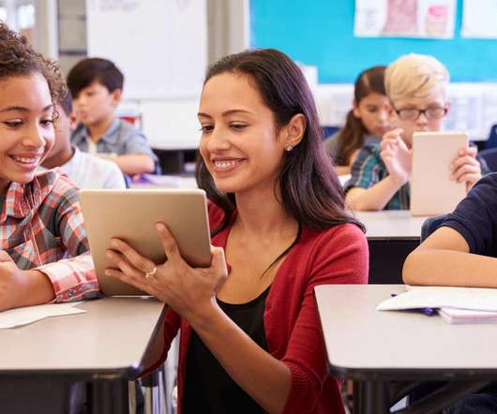
Related Work
Past work reports on a few autoethnographies of graduate students in the fields of education and disability studies.
Within computer science, however, researchers have only investigated singular aspects of graduate education (e.g., use of specialized classroom technologies).
Notes:
Past work reports on a few autoethnographies of graduate students, but in the fields of education and disability studies.
Within computer science, however, researchers have only investigated singular aspects of graduate education such as the use of specialized accessible technologies and the accessibility of specific classroom courses.

Slide 6
We examine longitudinal experiences from within, generating rich personal insights rarely available
through other research methods in HCI.
Notes:
Through an autoethnographic approach, we examine longitudinal insights from within, generating rich personal insights rarely available through other research methods in HCI.

Slide 7
Auto-ethnography
A qualitative research method where researcher adopts the role of participant and critically reflect on their experience.
We chose this method because disability is highly personal. We wanted to amplify our first-person voice as people with disabilities and as computer science researchers.
Specifically, we use trio-ethnography, a form of autoethnography, where three researcher-participants engage in a colloquial dialogue.
Notes:
But what is autoethnography? It’s a qualitative research method, where the researcher becomes a participant and critically reflects on their experience.
We chose this as a method because disability is highly personal, and we wanted a method to amplify our first-person voice as people with disabilities and as computer science researchers.
To be more specific, we use trio-ethnography, a form of autoethnography, where three researchers engage in a colloquial dialogue.

Slide 8
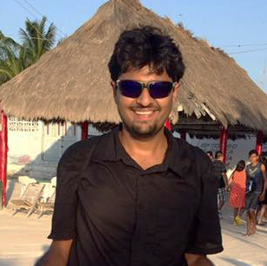
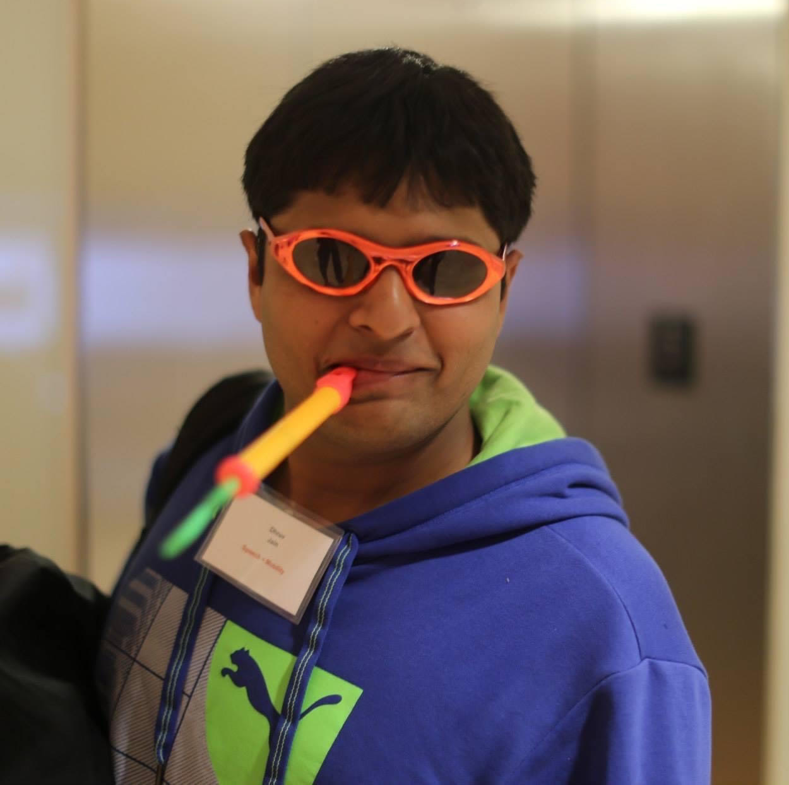

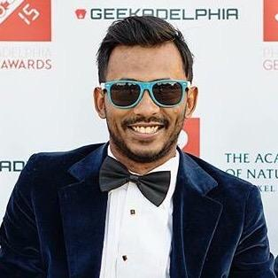
The Autoethnographers
DJ
Fourth year PhD, CSE, UW
From India
Hard-of-hearing
Venkatesh
Third year PhD, CSE, UW
From India
Blind
Ather
Third year PhD, CSE, UW
From Pakistan
Limited mobility
Notes:
Let me briefly introduce the autoethnographers.
We are third- and fourth-year computer science PhD students from the University of Washington.
We are also international students from India and Pakistan.
I am hard of hearing, Venkatesh is blind, and Ather has limited mobility.

Slide 9
We report on our experiences from earlier years of graduate school.
To document our experiences, we used we used a combination
of retrospective accounts and in-situ fieldnotes.
We analyzed the notes using open, axial and selective coding.
Method
Notes:
We report on our experiences from earlier years of graduate school (3 years for me, and 2 for Venkatesh and Ather).
To document our experiences, we used a combination of retrospective accounts and in-situ fieldnotes and
analyzed them using open, axial and selective coding.

Slide 10
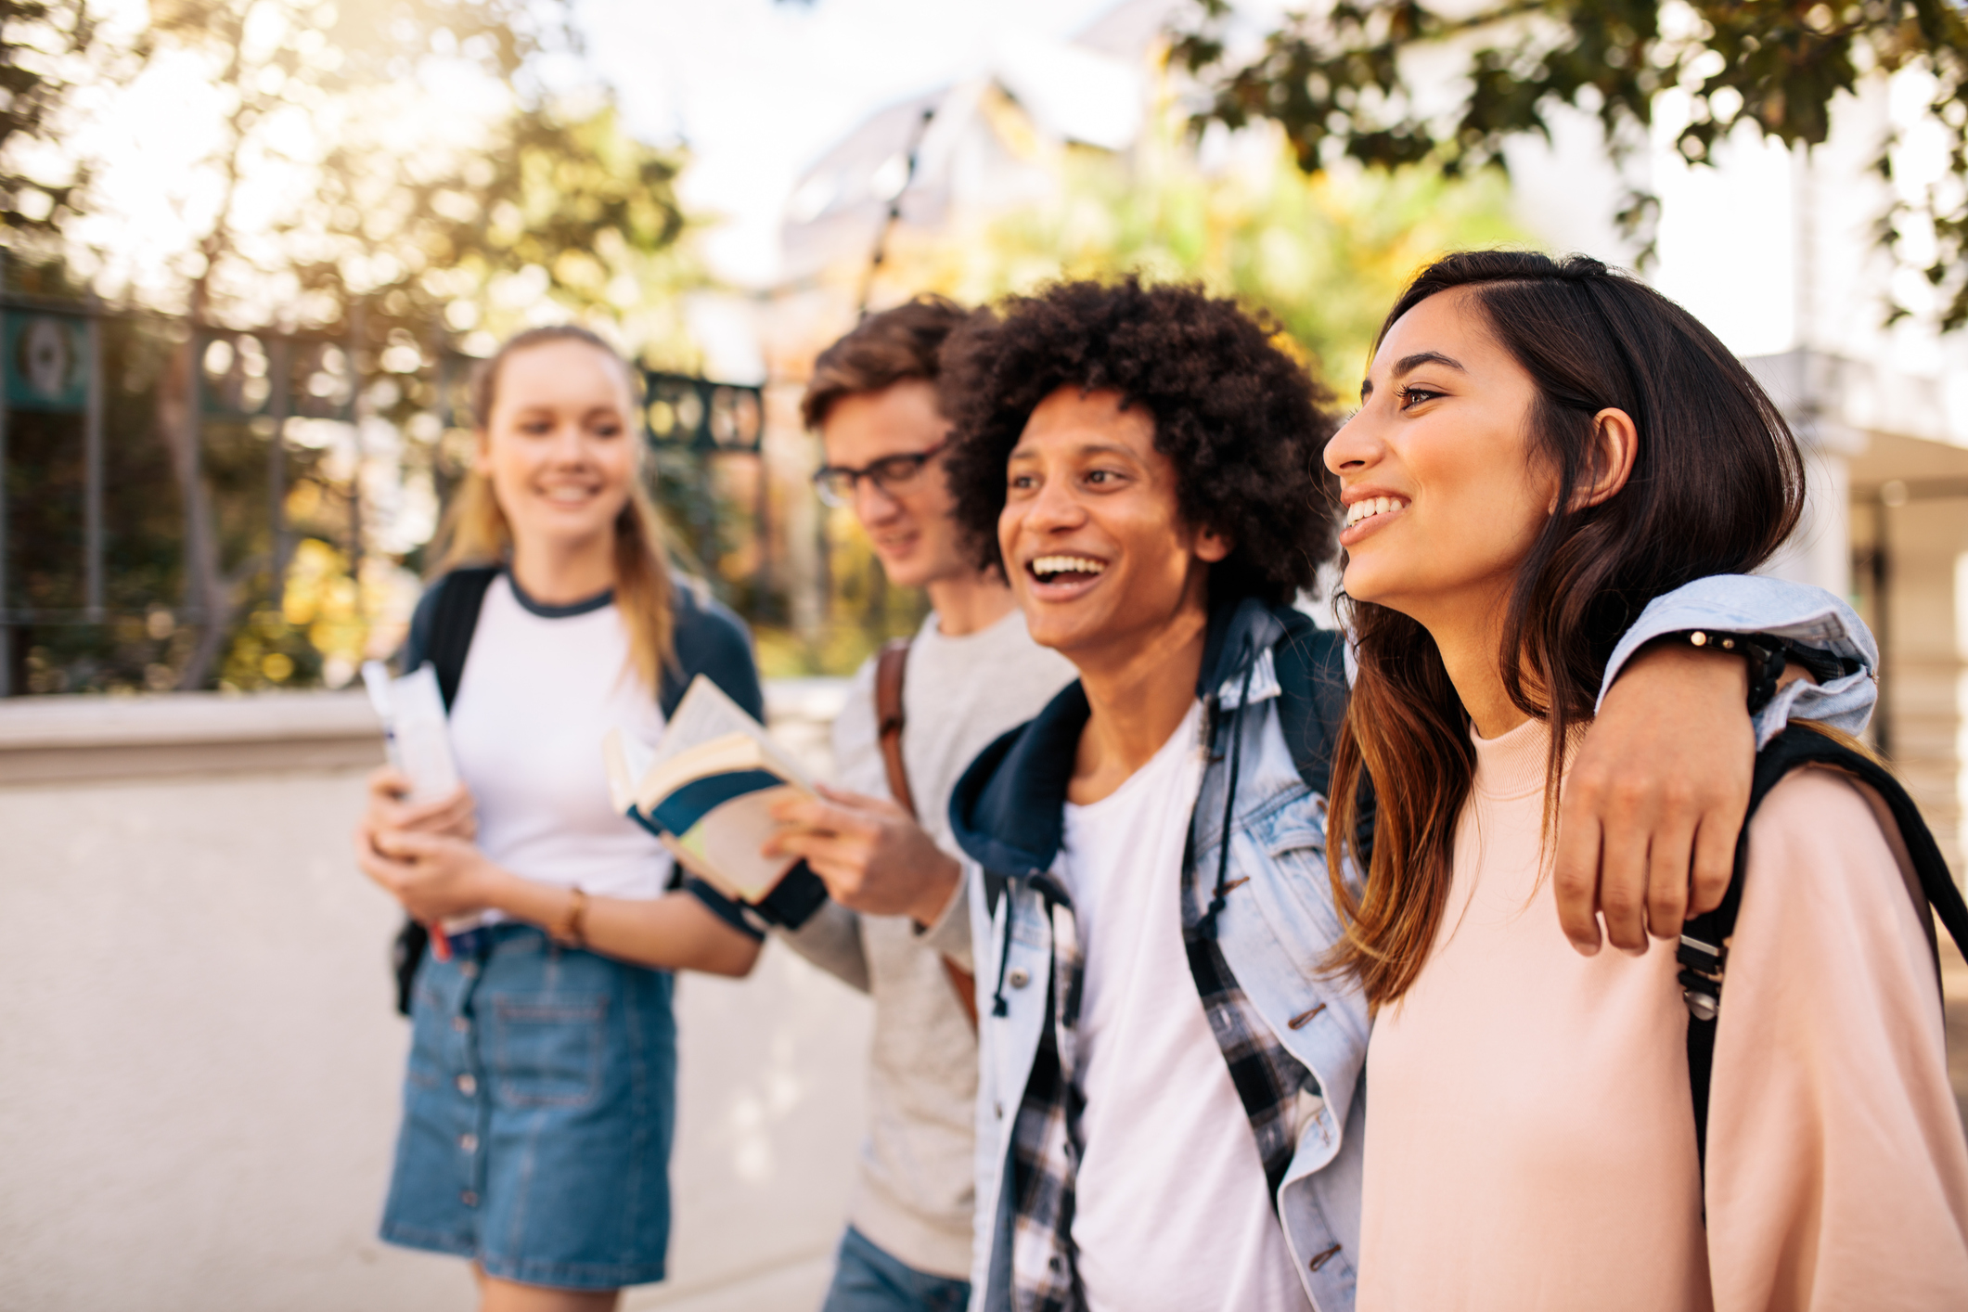
Themes
Self-image
Relationships
Technologies
Notes:
The documentation in the paper is very rich, but to fit the time, I will only highlight a few examples within three themes: how our self-image, relationships, and technology shape our disability and accommodation process.

Slide 11
Themes
Self-image
Notes:
First is self-image.

Slide 12
Themes
Self-image
Due to the cultural shift and the heightened expectations in the graduate school, we are sometimes conflicted in our ability to advocate for our needs.
Notes:
All of us are international students. Because of this cultural shift from Asia to the US coupled with the heightened expectations of the graduate school, we are sometimes conflicted in our ability to advocate for our needs and avail accommodations. This leads to tensions. For example, I wrote:

Slide 13
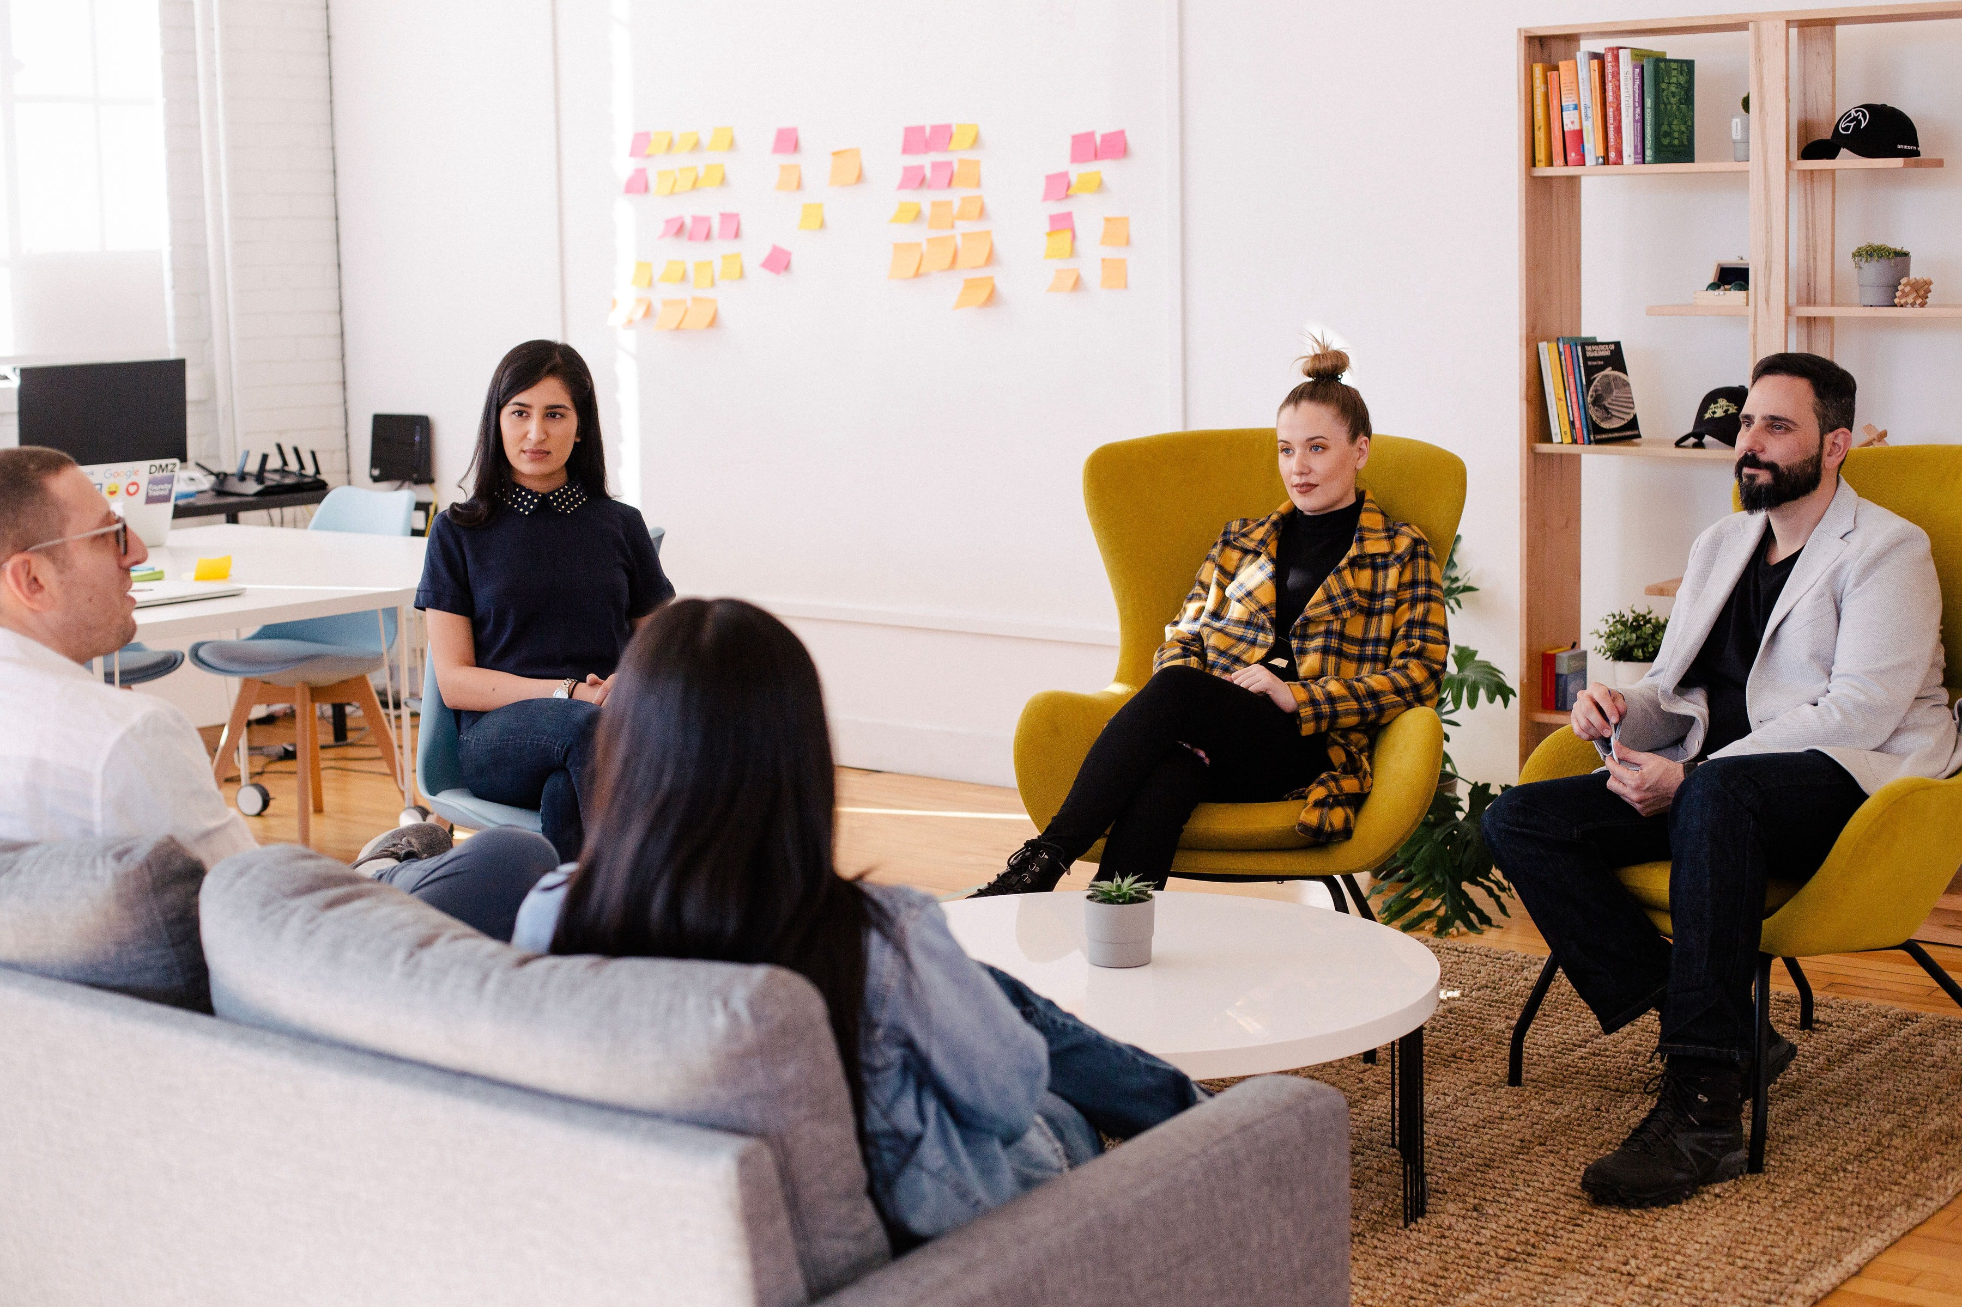
“I struggle with asking for accommodation — out of the fear of appearing rude.
- DJ, Feb 2018

Slide 14
“I struggle with asking for accommodation — out of the fear of appearing rude. As a foreign national, there is this continuous pressure of fitting into the American culture, of appearing friendly, and getting along well with others.
- DJ, Feb 2018

Slide 15
“I struggle with asking for accommodation — out of the fear of appearing rude. As a foreign national, there is this continuous pressure of fitting into the American culture, of appearing friendly, and getting along well with others. Plus there is a stress to prove myself in graduate school.
- DJ, Feb 2018

Slide 16
“I struggle with asking for accommodation — out of the fear of appearing rude. As a foreign national, there is this continuous pressure of fitting into the American culture, of appearing friendly, and getting along well with others. Plus there is a stress to prove myself in graduate school. All this leads to a constant worry in the meetings. As one example, I was in an HCI seminar and was not able to understand much.
- DJ, Feb 2018

Slide 17
“I struggle with asking for accommodation — out of the fear of appearing rude. As a foreign national, there is this continuous pressure of fitting into the American culture, of appearing friendly, and getting along well with others. Plus there is a stress to prove myself in graduate school. All this leads to a constant worry in the meetings. As one example, I was in an HCI seminar and was not able to understand much. Instead of asking 10 people [present in the meeting] to speak slowly and clearly, I just sat there, pretending to do my own thing, trying to fit in...”
- DJ, Feb 2018

Slide 18
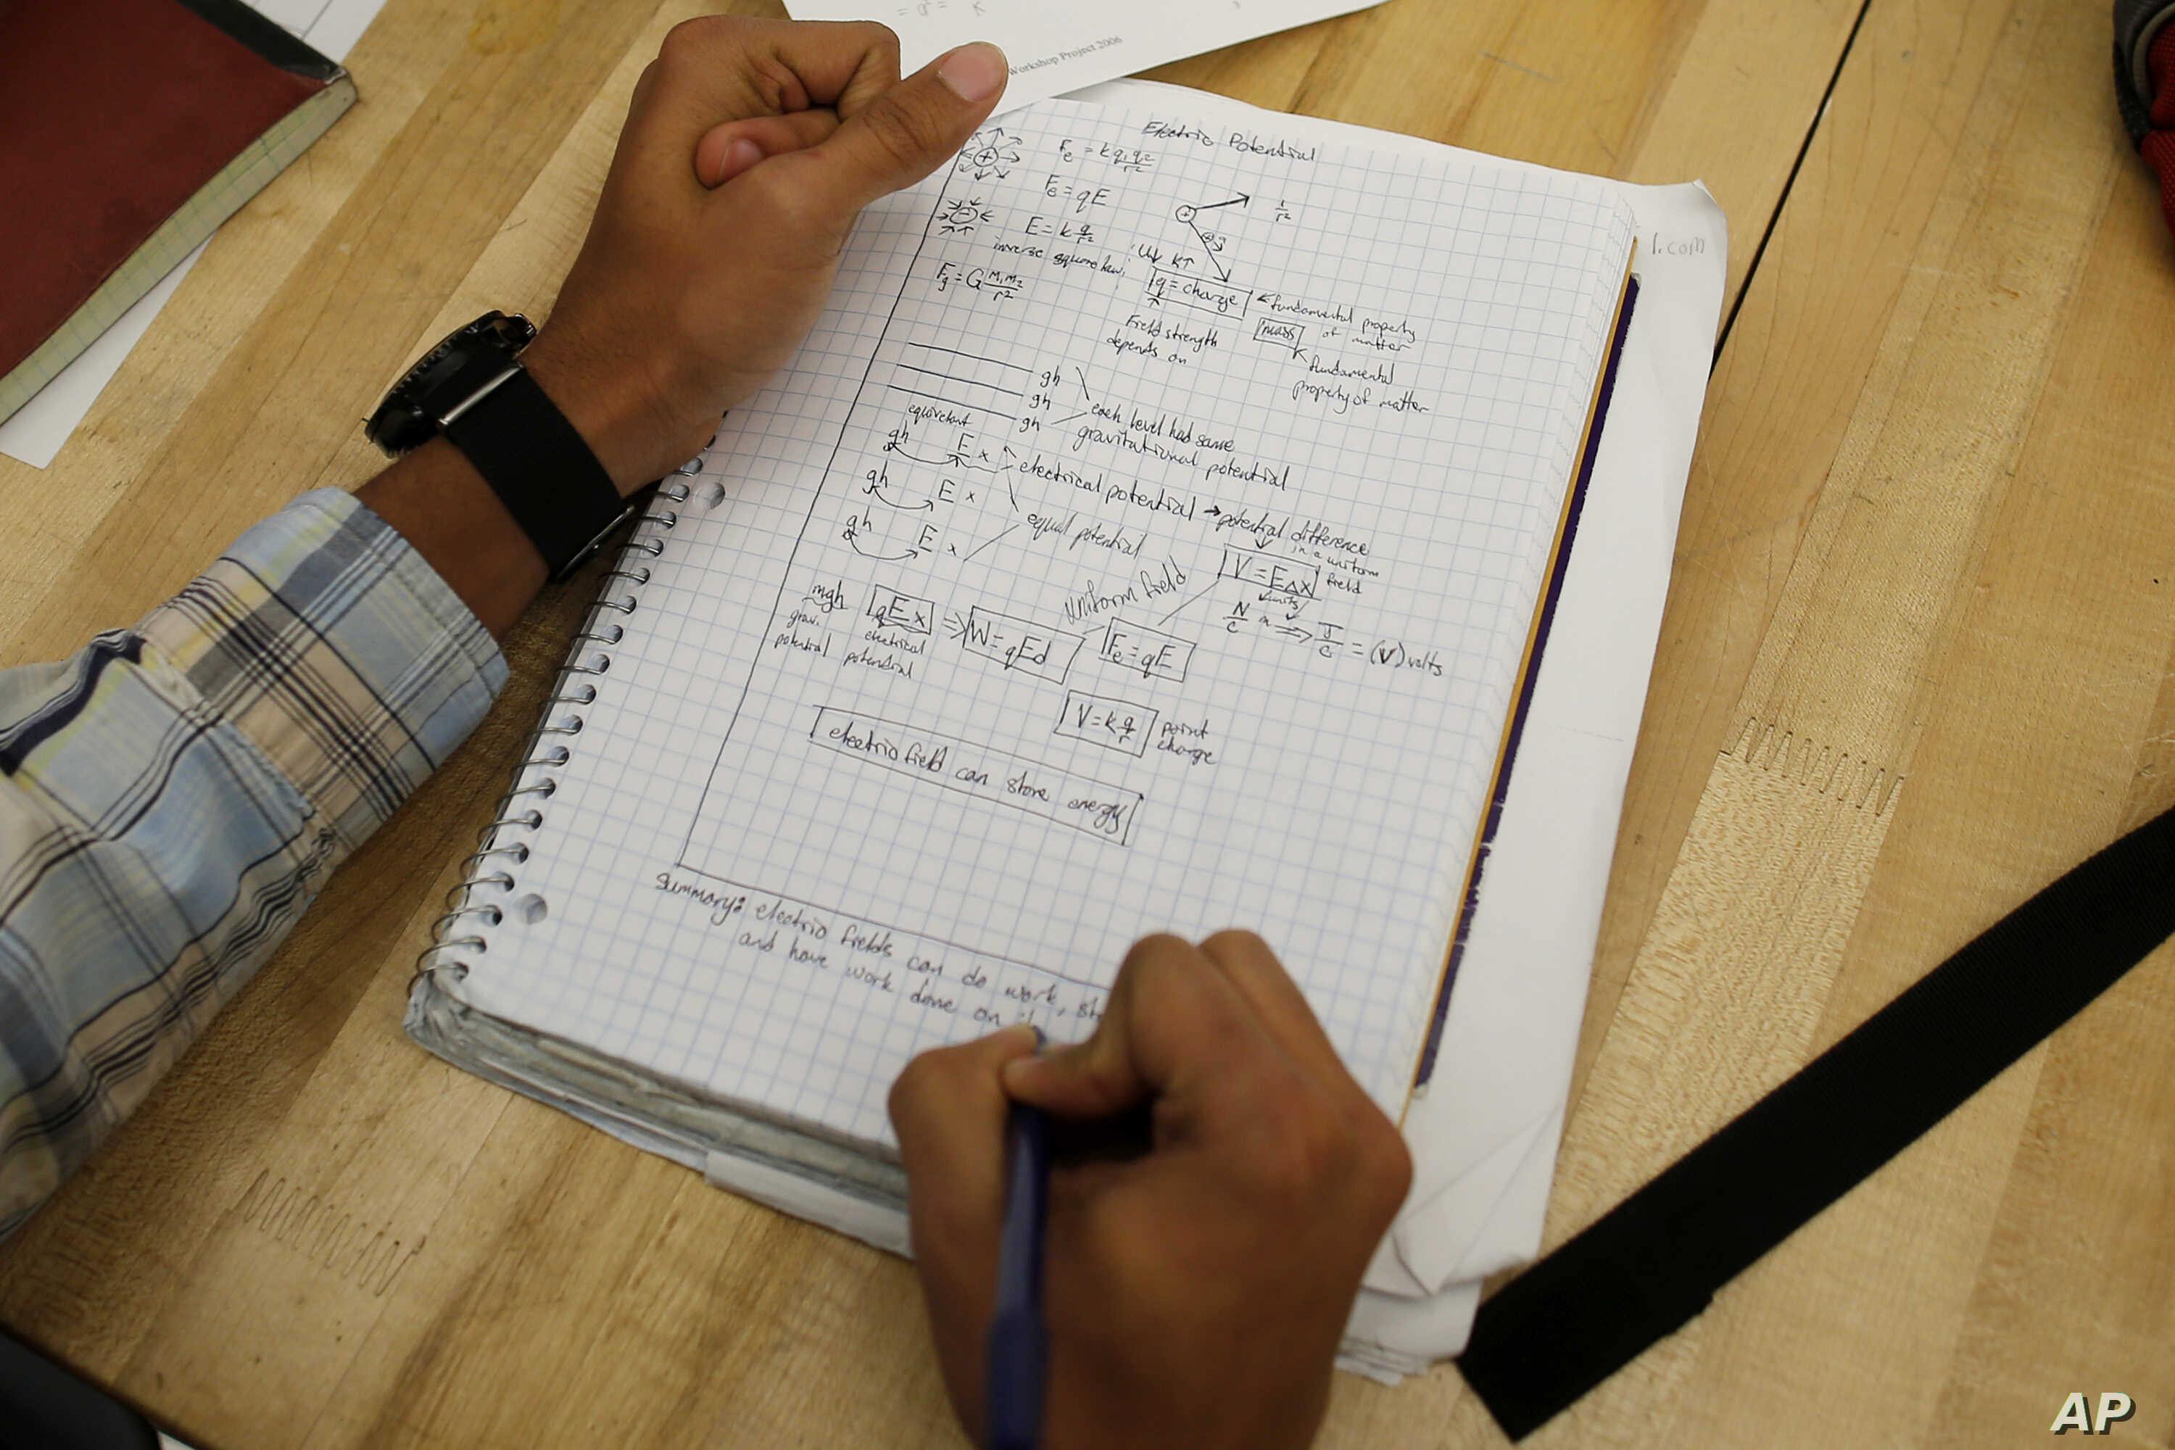
- Ather, Jan 2019
Notes:
Similarly, Ather wrote:

Slide 19
“In an attempt to be ‘normal’, I tried to take notes myself during [my] meetings with [a potential advisor].
- Ather, Jan 2019

Slide 20
“In an attempt to be ‘normal’, I tried to take notes myself during [my] meetings with [a potential advisor]. [Because of my limited dexterity in hands,] my notes are always incomplete…
- Ather, Jan 2019

Slide 21
“In an attempt to be ‘normal’, I tried to take notes myself during [my] meetings with [a potential advisor]. [Because of my limited dexterity in hands,] my notes are always incomplete… But I didn’t ask for help. [Writing notes myself] is one of those things that make me feel like the other students.
- Ather, Jan 2019

Slide 22
“In an attempt to be ‘normal’, I tried to take notes myself during [my] meetings with [a potential advisor]. [Because of my limited dexterity in hands,] my notes are always incomplete… But I didn’t ask for help. [Writing notes myself] is one of those things that make me feel like the other students. It was also because at the [beginning of graduate school], I really wanted him as an advisor and wanted to impress him [instead of appearing incompetent].”
- Ather, Jan 2019

Slide 23
These examples show graduate school can magnify the fears of disclosure
due to increased self-expectation and due to power relationships.
“In an attempt to be ‘normal’, I tried to take notes myself during [my] meetings with [a potential advisor]. [Because of my limited dexterity in hands,] my notes are always incomplete… But I didn’t ask for help. [Writing notes myself] is one of those things that make me feel like the other students. It was also because at the [beginning of graduate school], I really wanted him as an advisor and wanted to impress him [instead of appearing incompetent].”
- Ather, Jan 2019
Notes:
These examples show graduate school can magnify the fears of disclosure due to increased self-expectation and due to power relationships.

Slide 24
Themes
Self-image
Notes:
This brings us to our second theme [slide] relationships, which [slide] further details how complex relationships impact disability and the accommodation process. Let me talk about an example of Venkatesh, the blind author’s, experience:

Slide 25
Themes
Self-image
Relationships
Notes:
This brings us to our second theme [slide] relationships, which [slide] further details how complex relationships impact disability and the accommodation process. Let me talk about an example of Venkatesh, the blind author’s, experience:

Slide 26
Themes
Self-image
Relationships
Complex relationships in graduate school impact our
disability and the accommodation process.
Notes:
This brings us to our second theme [slide] relationships, which [slide] further details how complex relationships impact disability and the accommodation process. Let me talk about an example of Venkatesh, the blind author’s, experience:

Slide 27
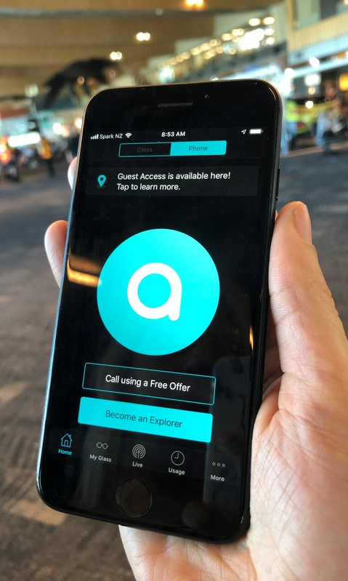
“As part of an event, a few CSE students had decided to hangout at the beach. I wanted to go as well. [...] I took an Uber to the beach [...]

Slide 28
“As part of an event, a few CSE students had decided to hangout at the beach. I wanted to go as well. [...] I took an Uber to the beach [...] I was worried about how I would find the group once I got there. The event organizer just sent a picture to the event page saying, “we found a spot”.

Slide 29
“As part of an event, a few CSE students had decided to hangout at the beach. I wanted to go as well. [...] I took an Uber to the beach [...] I was worried about how I would find the group once I got there. The event organizer just sent a picture to the event page saying, “we found a spot”.
Ok, I thought I’ll just send the picture to Aira (the visual interpreter service) and have them find the group for me.

Slide 30
“As part of an event, a few CSE students had decided to hangout at the beach. I wanted to go as well. [...] I took an Uber to the beach [...] I was worried about how I would find the group once I got there. The event organizer just sent a picture to the event page saying, “we found a spot”.
Ok, I thought I’ll just send the picture to Aira (the visual interpreter service) and have them find the group for me.
[However,] when I got to the beach, I became a little anxious. So, I tried to call [a friend] whose phone number I had but she didn’t answer. I posted in the event group: “I am at the entrance. Can somebody get me?”

Slide 31
“As part of an event, a few CSE students had decided to hangout at the beach. I wanted to go as well. [...] I took an Uber to the beach [...] I was worried about how I would find the group once I got there. The event organizer just sent a picture to the event page saying, “we found a spot”.
Ok, I thought I’ll just send the picture to Aira (the visual interpreter service) and have them find the group for me.
[However,] when I got to the beach, I became a little anxious. So, I tried to call [a friend] whose phone number I had but she didn’t answer. I posted in the event group: “I am at the entrance. Can somebody get me?”
I got a text back: “Knowing where you are would help :)”

Slide 32
I wanted to say “I obviously don’t know where I am” but I didn’t want to appear as this helpless person asking for help [...]

Slide 33
I wanted to say “I obviously don’t know where I am” but I didn’t want to appear as this helpless person asking for help [...] [So,] I opened Aira and called the agent. It was an extremely stressful situation because I had to send the picture of the spot to the Aira agent, and [to upload the picture], I was asked to share my Facebook password because the email wasn’t working for some reason.

Slide 34
I wanted to say “I obviously don’t know where I am” but I didn’t want to appear as this helpless person asking for help [...] [So,] I opened Aira and called the agent. It was an extremely stressful situation because I had to send the picture of the spot to the Aira agent, and [to upload the picture], I was asked to share my Facebook password because the email wasn’t working for some reason. Sharing password with a random stranger!

Slide 35
I wanted to say “I obviously don’t know where I am” but I didn’t want to appear as this helpless person asking for help [...] [So,] I opened Aira and called the agent. It was an extremely stressful situation because I had to send the picture of the spot to the Aira agent, and [to upload the picture], I was asked to share my Facebook password because the email wasn’t working for some reason. Sharing password with a random stranger!
And on top of that [since the app uses the phone camera], I was afraid that people might perceive me as a weirdo or pervert taking pictures of people and women! [...]

Slide 36
I wanted to say “I obviously don’t know where I am” but I didn’t want to appear as this helpless person asking for help [...] [So,] I opened Aira and called the agent. It was an extremely stressful situation because I had to send the picture of the spot to the Aira agent, and [to upload the picture], I was asked to share my Facebook password because the email wasn’t working for some reason. Sharing password with a random stranger!
And on top of that [since the app uses the phone camera], I was afraid that people might perceive me as a weirdo or pervert taking pictures of people and women! [...]
Luckily, I found a few other people who were also looking for the group on the beach. I ended the [Aira] call there.”

Slide 37
This example shows how complex relationships (with peers on the beach, Aira agent)
can cause issues of privacy and inaccessibility while using an accessible technology.
I wanted to say “I obviously don’t know where I am” but I didn’t want to appear as this helpless person asking for help [...] [So,] I opened Aira and called the agent. It was an extremely stressful situation because I had to send the picture of the spot to the Aira agent, and [to upload the picture], I was asked to share my Facebook password because the email wasn’t working for some reason. Sharing password with a random stranger!
And on top of that [since the app uses the phone camera], I was afraid that people might perceive me as a weirdo or pervert taking pictures of people and women! [...]
Luckily, I found a few other people who were also looking for the group on the beach. I ended the [Aira] call there.”
Notes:
This example shows how complex relationships can cause issues of privacy and inaccessibility while using the very same technology that was supposed to be instead accommodating a disability.

Slide 38
Themes
Self-image
Relationships
Notes:
In the third theme, technologies [slide] we show [slide] another example of how accessible technologies themselves can cause barriers, specifically when people with different disabilities interact with each other. Here is an example from my notes:

Slide 39
Themes
Self-image
Relationships
Technologies
Notes:
In the third theme, technologies [slide] we show [slide] another example of how accessible technologies themselves can cause barriers, specifically when people with different disabilities interact with each other. Here is an example from my notes:

Slide 40
Themes
Self-image
Relationships
Technologies
Accessible technologies can cause barriers, specifically when people with different disabilities interact with each other.
Notes:
In the third theme, technologies [slide] we show [slide] another example of how accessible technologies themselves can cause barriers, specifically when people with different disabilities interact with each other. Here is an example from my notes:

Slide 41
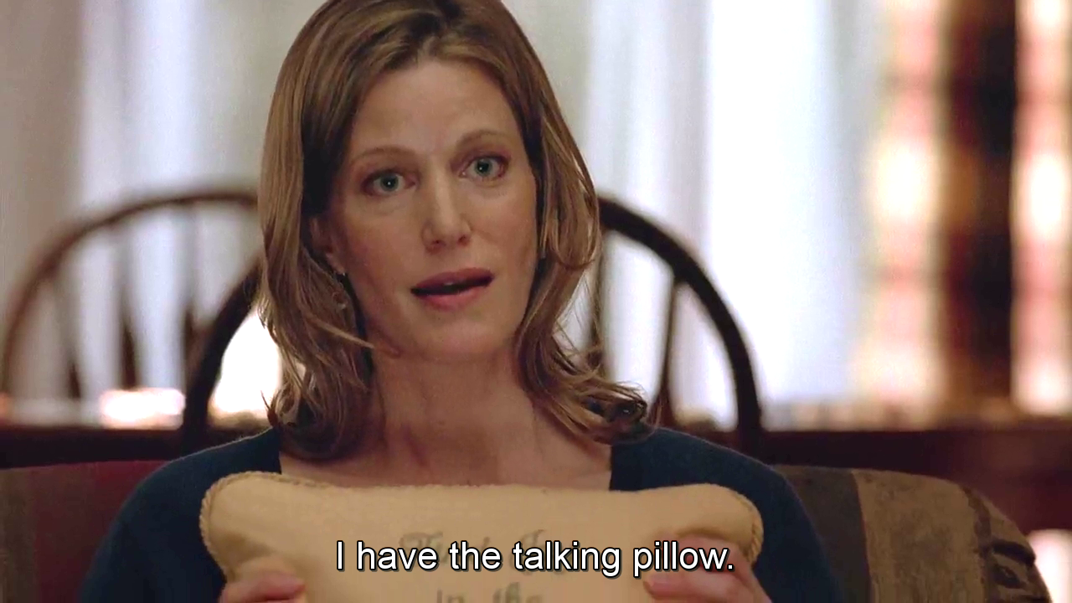
“I am hard of hearing.
- DJ, Jul 2019

Slide 42
“I am hard of hearing. To accommodate me in the in-person accessibility seminar, we used the talking pillow approach, where we circulated objects such as a soft ball or a pen, and only the person possessing the object was allowed to speak.
- DJ, Jul 2019

Slide 43
“I am hard of hearing. To accommodate me in the in-person accessibility seminar, we used the talking pillow approach, where we circulated objects such as a soft ball or a pen, and only the person possessing the object was allowed to speak. This made so much difference! The pillow ensured that people speak one at a time and, since I read lips, gave me a visual indicator of who is speaking.
- DJ, Jul 2019

Slide 44
“I am hard of hearing. To accommodate me in the in-person accessibility seminar, we used the talking pillow approach, where we circulated objects such as a soft ball or a pen, and only the person possessing the object was allowed to speak. This made so much difference! The pillow ensured that people speak one at a time and, since I read lips, gave me a visual indicator of who is speaking. I felt belonged, included, and being able to productively participate!”
- DJ, Jul 2019

Slide 45
However, all the visual cues that I benefited from were inaccessible
to Venkatesh who was also the part of the seminar…
“I am hard of hearing. To accommodate me in the in-person accessibility seminar, we used the talking pillow approach, where we circulated objects such as a soft ball or a pen, and only the person possessing the object was allowed to speak. This made so much difference. The pillow ensured that people speak one at a time and, since I read lips, gave me a visual indicator of who is speaking. I felt belonged, included, and being able to productively participate!”
- DJ, Jul 2019
Notes:
However, all the visual cues that I benefited from were inaccessible to Venkatesh, our blind author, who was also the part of the seminar. He wrote:

Slide 46
“While the pillow was really necessary for DJ, it caused somewhat of an access barrier for me because I couldn’t see it being circulated around...”
- Venkatesh, Sep 2019
Notes:
He added:

Slide 47
“While the pillow was really necessary for DJ, it caused somewhat of an access barrier for me because I couldn’t see it being circulated around...”
“However, I eventually got over it as it was an “accessibility seminar” [...] Many people missed catching the pillow as it was thrown around and so it became a “funny” playful thing where people would laugh if anybody, including me, missed catching.”
- Venkatesh, Sep 2019

Slide 48
Our experiences show how (in)accessibility
really happens in the details using
social, cultural, and emotional negotiation.
Notes:
In summary, our experiences show how inaccessibility really occurs in the details by highlighting the social-cultural negotiation process and the emotional burden involved.

Slide 49
While advance planning and care can
improve access, not all situations
can be accommodated beforehand.
Notes:
We show that, while advance planning and care can certainly improve access and should be done, not all situations can be accommodated beforehand.

Slide 50
So, what to do?
Notes:
So, what to do?

Slide 51
“Uncharted Accommodations”
In the paper, we propose four ad-hoc in-situ accommodations:
Proactive customization
Effective collaborations
Community participation
Repurposing existing technologies
Notes:
In our paper, we propose four types of uncharted accommodations, that is, [slide] ad hoc in-situ accommodations: proactive customization, effective collaborations, community participation, and repurposing existing technologies for in-situ needs. While I’d like to discuss them, in the interest of time, I request you to instead read them in the paper, so we can [slide] together make graduate school more inclusive!
Thank you.

Slide 52
Let’s together make graduate school
More inclusive!
For more information: bit.ly/navgrad
Notes:
In our paper, we propose four types of uncharted accommodations, that is, ad hoc in-situ accommodations: proactive customization, fostering effective collaborations, encouraging community participation, and repurposing existing technologies for in-situ needs. While I’d like to discuss them, in the interest of time, I request you to instead read them in the paper, so we can [slide] together make graduate school more inclusive!
Thank you.
For more information, please look at our paper on the link: bit.ly/navgrad

