Slide 1
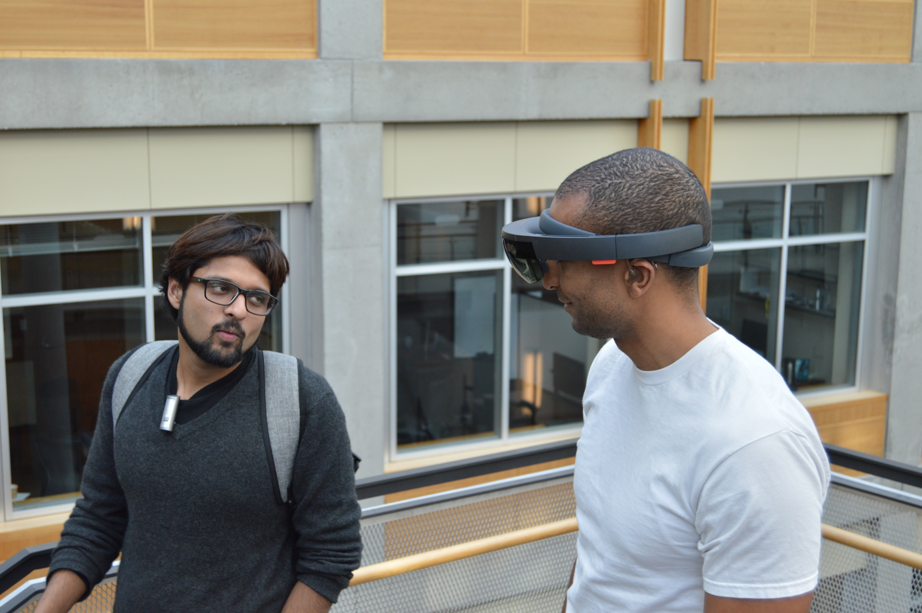
Towards Accessible Conversations in a Mobile Context for People who
are Deaf or Hard of Hearing
We’re going down the
stairs now…
Dhruv Jain, Rachel Franz, Leah Findlater, Jackson Cannon, Raja Kushalnagar, and Jon Froehlich
University of Washington, Seattle
Gallaudet University

Slide 2
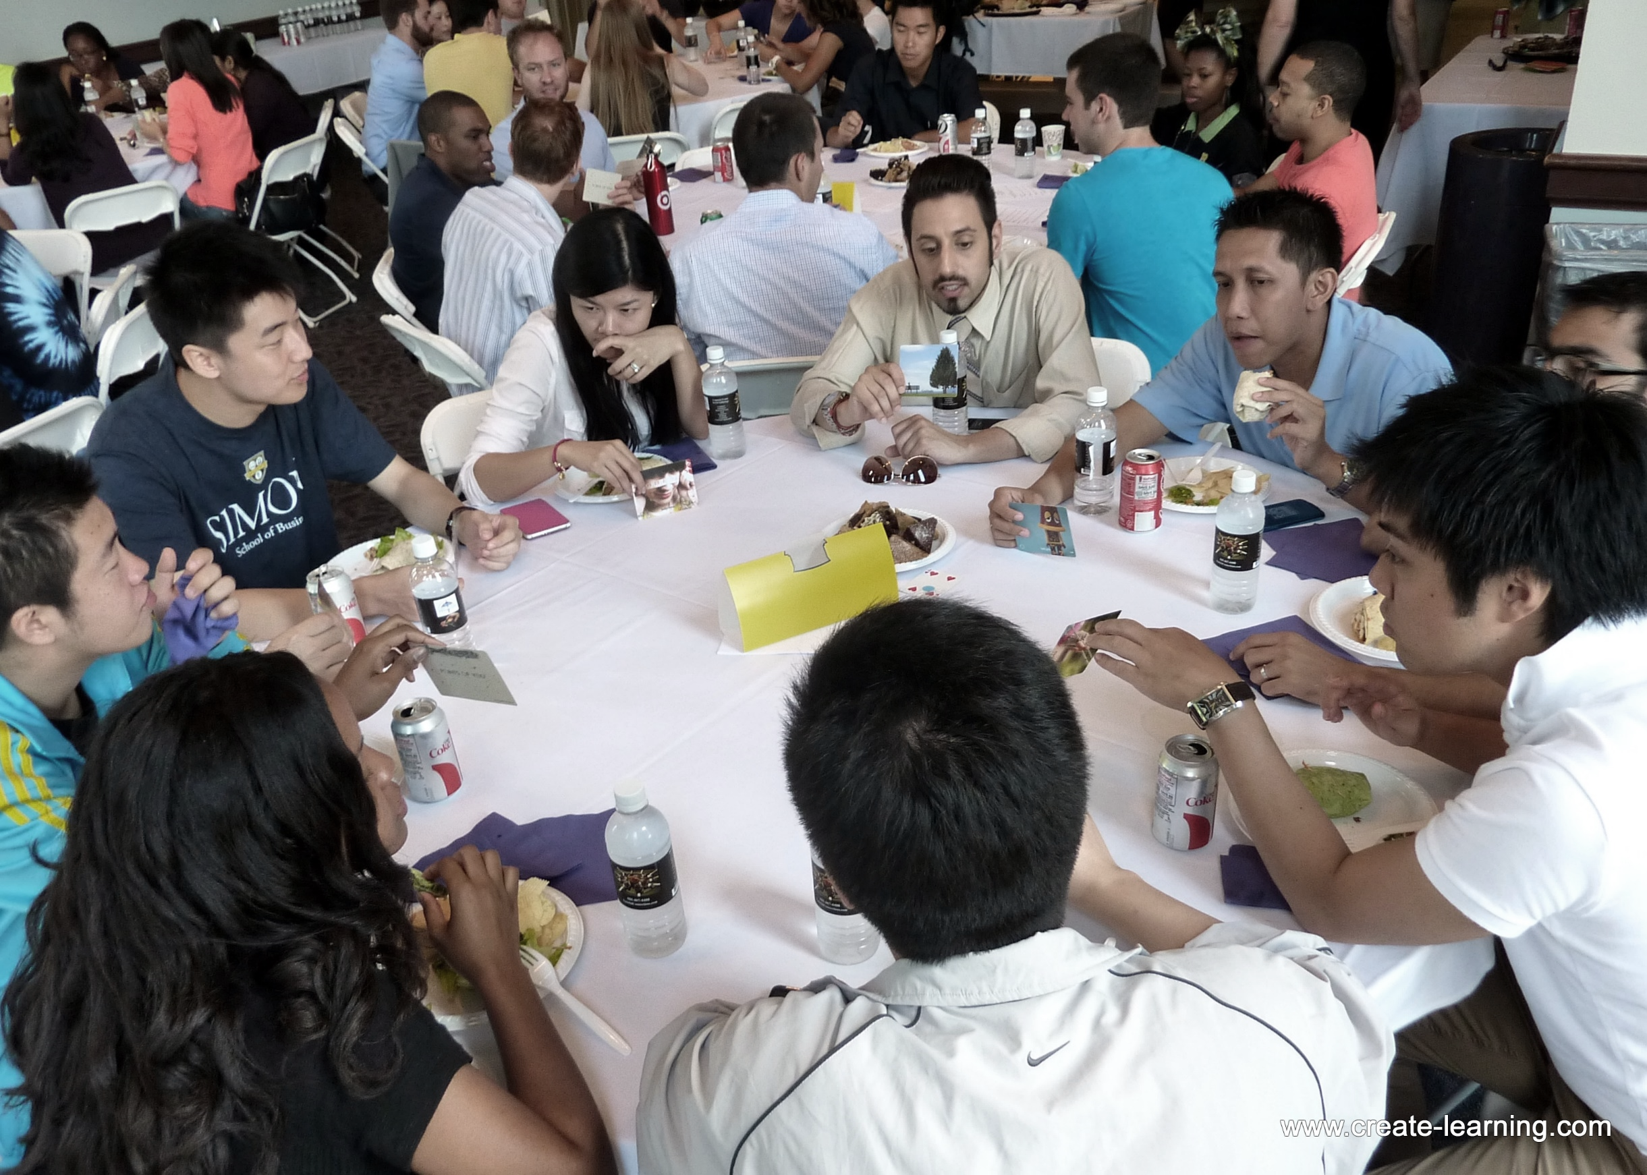
Prior work have investigated communication challenges of DHH people
in stationary contexts such as group meetings and lectures.

Slide 3

Prior work have investigated communication challenges of DHH people
in stationary contexts such as group meetings and lectures.
Moving conversations (e.g., walking) could present new challenges such as
varying background noise and needing to balance visual attention
between looking at the speakers and looking ahead.

Slide 4
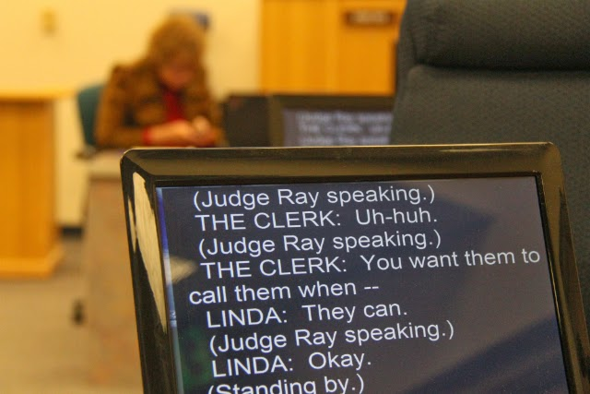
Moreover, assistive technologies like real-time captioning have been traditionally designed for stationary context and are not conducive to mobile scenarios.

Slide 5

Aims

Slide 6
Aims
1
To investigate the needs of DHH people in mobile conversations such as walking and transit.

Slide 7
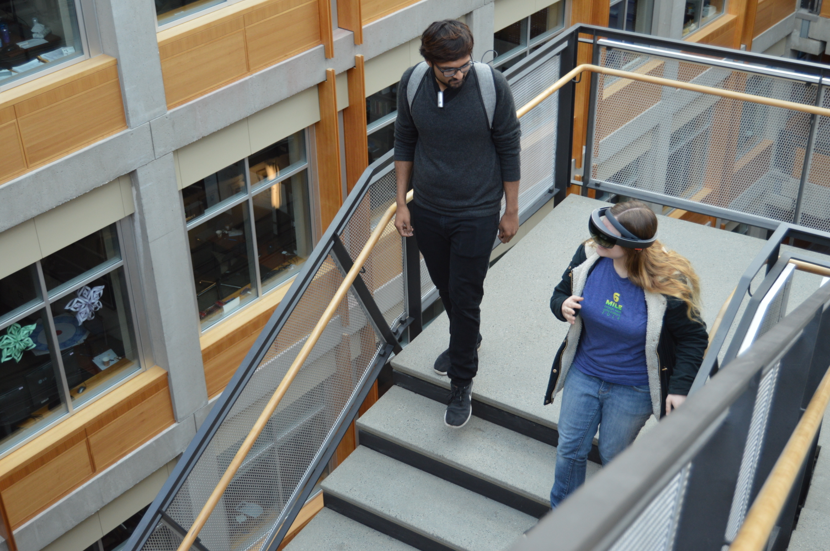
Aims
1
To investigate the needs of DHH people in mobile conversations such as walking and transit.
To study the possibility of captions on head mounted displays (HMDs) to support those needs.
2

Slide 8
This Paper

Slide 9
This Paper
Study 1: Formative interview with 12 DHH participants on challenges, communication strategies, and future captioning technology.

Slide 10
This Paper
Study 1: Formative interview with 12 DHH participants on challenges, communication strategies, and future captioning technology.
Study 2: Evaluation of a proof-of-concept HMD-captioning prototype with 10 DHH participants in a walking scenario.

Slide 11
Outline
Background and Past Work

Slide 12
Outline
Background and Past Work
Study 1:
Interview

Slide 13
Outline
Background and Past Work
Study 1:
Interview
Proof-of-Concept HMD Prototype

Slide 14
Outline
Background and Past Work
Study 1:
Interview
Proof-of-Concept HMD Prototype
Study 2: Evaluation

Slide 15
Background and Past Work
Study 1:
Interview
Proof-of-Concept HMD Prototype
Study 2: Evaluation

Slide 16
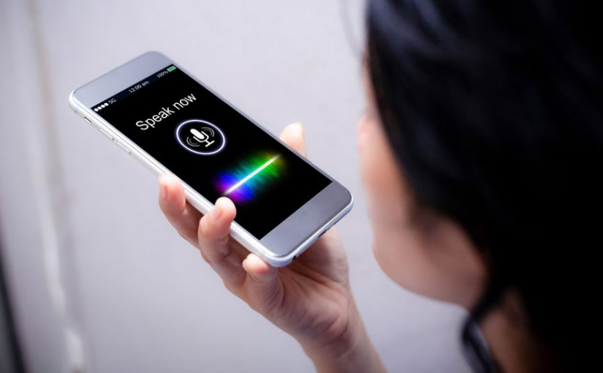
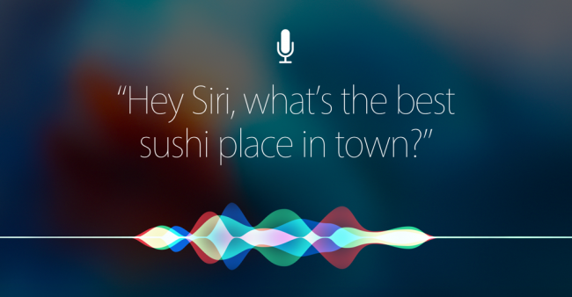
Captions can be generated in two ways:
Automatic Speech Recognition (ASR)

Slide 17
Automatic Speech Recognition (ASR)

Slide 18
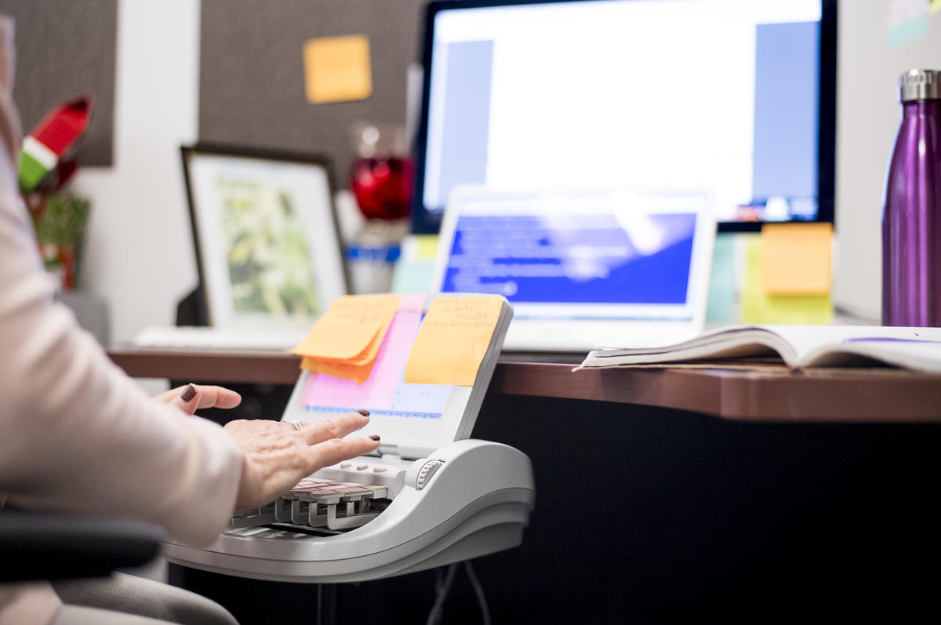
Trained Transcriber

Slide 19
We used a trained transcriber (or real-time captioning).
Trained Transcriber

Slide 20
We used a trained transcriber (or real-time captioning).
Captions from a trained transcriber are typically shown on a
laptop or a large shared screen.
Trained Transcriber

Slide 21
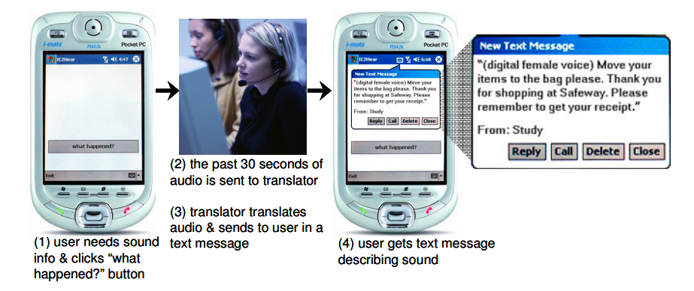
Thus, researchers have explored mobile and wearable solutions.
Matthews et al., UbiComp 2006

Slide 22
Matthews et al., UbiComp 2006

Slide 23
Though portable, smartphone apps require that users turn their
gaze away from the speaker or environment.
Matthews et al., UbiComp 2006

Slide 24
To reduce this visual split, researchers have used HMD to show captions.
Peng et al., CHI 2018

Slide 25
Peng et al., CHI 2018

Slide 26
However, no work has evaluated HMD-based captioning in a
mobile context.

Slide 27
Background and Past Work
Study 1:
Interview
Proof-of-Concept HMD Prototype
Study 2: Evaluation

Slide 28
Background and Past Work
Study 1:
Interview
Proof-of-Concept HMD Prototype
Study 2: Evaluation

Slide 29
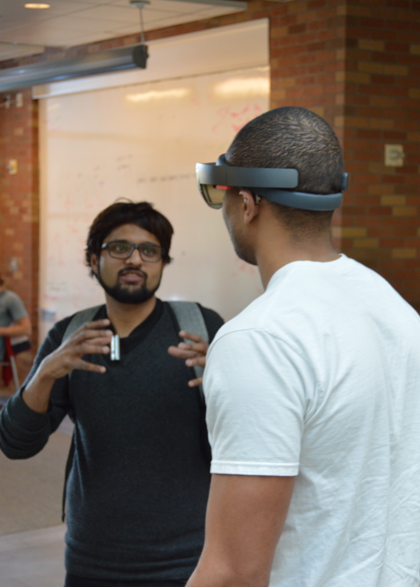
Study 1

Slide 30
Study 1
Goal
To assess the communication needs and potential technologies for DHH people in mobile contexts.

Slide 31
Study 1
Goal
To assess the communication needs and potential technologies for DHH people in mobile contexts.
Participants
12 DHH individuals (5 males, 6 females, 1 did not disclose)
Recruited through email, social media and snowball sampling

Slide 32
Study 1
Goal
To assess the communication needs and potential technologies for DHH people in mobile contexts.
Participants
12 DHH individuals (5 males, 6 females, 1 did not disclose)
Recruited through email, social media and snowball sampling
Study Method
Two part semi-structured formative interview in lab-setting: (i) challenges in a mobile conversation, (ii) ideas for future captioning technology
Three mobile scenarios were explicitly explored: walking, in transit, and recreational.

Slide 33
Background and Past Work
Study 1:
Interview
Proof-of-Concept HMD Prototype
Study 2: Evaluation

Slide 34
Background and Past Work
Study 1:
Interview
Proof-of-Concept HMD Prototype
Study 2: Evaluation
PART 1:
Mobile conversation challenges

Slide 35
Background and Past Work
Study 1:
Interview
Proof-of-Concept HMD Prototype
Study 2: Evaluation
PART 1:
Mobile conversation challenges
PART 2:
Captioning technology design

Slide 36
Background and Past Work
Study 1:
Interview
Proof-of-Concept HMD Prototype
Study 2: Evaluation
PART 1:
Mobile conversation challenges

Slide 37
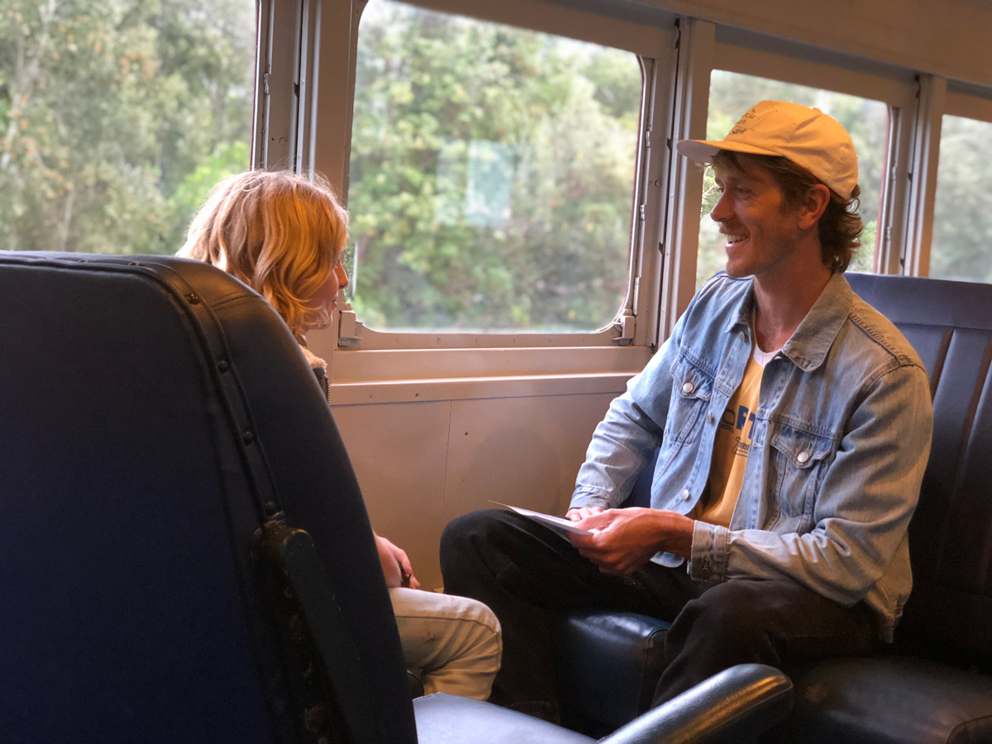
Participants had mobile conversations while walking to or from meetings,
classes, and social activities as well as on public transport and in cars.
STUDY 1 PART 1: CHARACTERISTICS

Slide 38
Participants had mobile conversations while walking to or from meetings,
classes, and social activities as well as on public transport and in cars.
Assistive technology use in mobile contexts is rare.
STUDY 1 PART 1: CHARACTERISTICS

Slide 39

“
“I don't usually use technology other than hearing aids in moving conversations. I will occasionally use my phone to type something if it’s impossible to hear. The [phone] isn't perfect because it demands that I split my attention and [also] have one [hand] holding the phone.”
”
- P12

Slide 40
Moving Conversation Challenges
STUDY 1 PART 1: CHALLENGES

Slide 41
Moving Conversation Challenges
STUDY 1 PART 1: CHALLENGES
Conversations are brief and shallow

Slide 42
Moving Conversation Challenges
STUDY 1 PART 1: CHALLENGES
Conversations are brief and shallow
Hearing people do not understand and accommodate needs

Slide 43

“
“If I need to look away for some reason, a deaf person will automatically stop talking and resume when I’m ready. A spoken conversation doesn’t have that type of natural stop and start…”
”
- P10

Slide 44
Moving Conversation Challenges
STUDY 1 PART 1: CHALLENGES
Conversations are brief and shallow
Hearing people do not understand and accommodate needs

Slide 45
Moving Conversation Challenges
STUDY 1 PART 1: CHALLENGES
Conversations are brief and shallow
Hearing people do not understand and accommodate needs
Recreational activities are particularly challenging

Slide 46
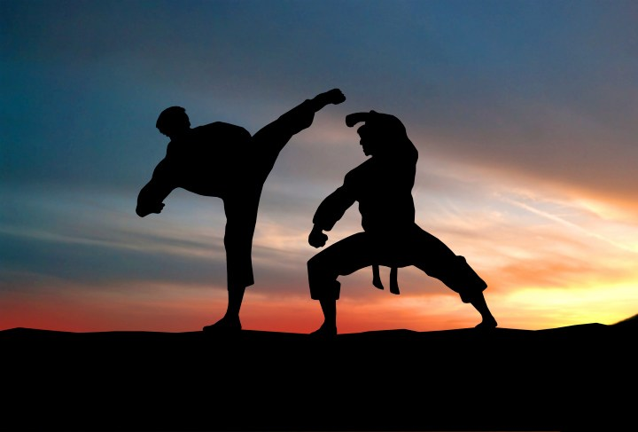
“
“[In] martial arts: you have an instructor showing how to move the arms, hands, body, etc. while talking to describe it. Well if they have to “talk” by signing, then how the hell do they also show you how to hold your arms in the proper position?”
”
- P12

Slide 47
Moving Conversation Challenges
STUDY 1 PART 1: CHALLENGES
Conversations are brief and shallow
Hearing people do not understand and accommodate needs
Recreational activities are particularly challenging

Slide 48
Moving Conversation Challenges
STUDY 1 PART 1: CHALLENGES
Conversations are brief and shallow
Hearing people do not understand and accommodate needs
Recreational activities are particularly challenging
Challenges of varying space, lighting and background noise

Slide 49
Background and Past Work
Study 1:
Interview
Proof-of-Concept HMD Prototype
Study 2: Evaluation
PART 1:
Characteristics
and Challenges

Slide 50
Background and Past Work
Study 1:
Interview
Proof-of-Concept HMD Prototype
Study 2: Evaluation
PART 1:
Characteristics
and Challenges
PART 2:
Captioning Technology Design

Slide 51

All participants said they would use real-time captioning in at least
one moving conversation scenario (walking, transit or recreational activity).
STUDY 1 PART 2: TECHNOLOGY

Slide 52
All participants said they would use real-time captioning in at least
one moving conversation scenario (walking, transit or recreational activity).
However, some were concerned that captions may affect
conversation quality (N=7).
STUDY 1 PART 2: TECHNOLOGY

Slide 53
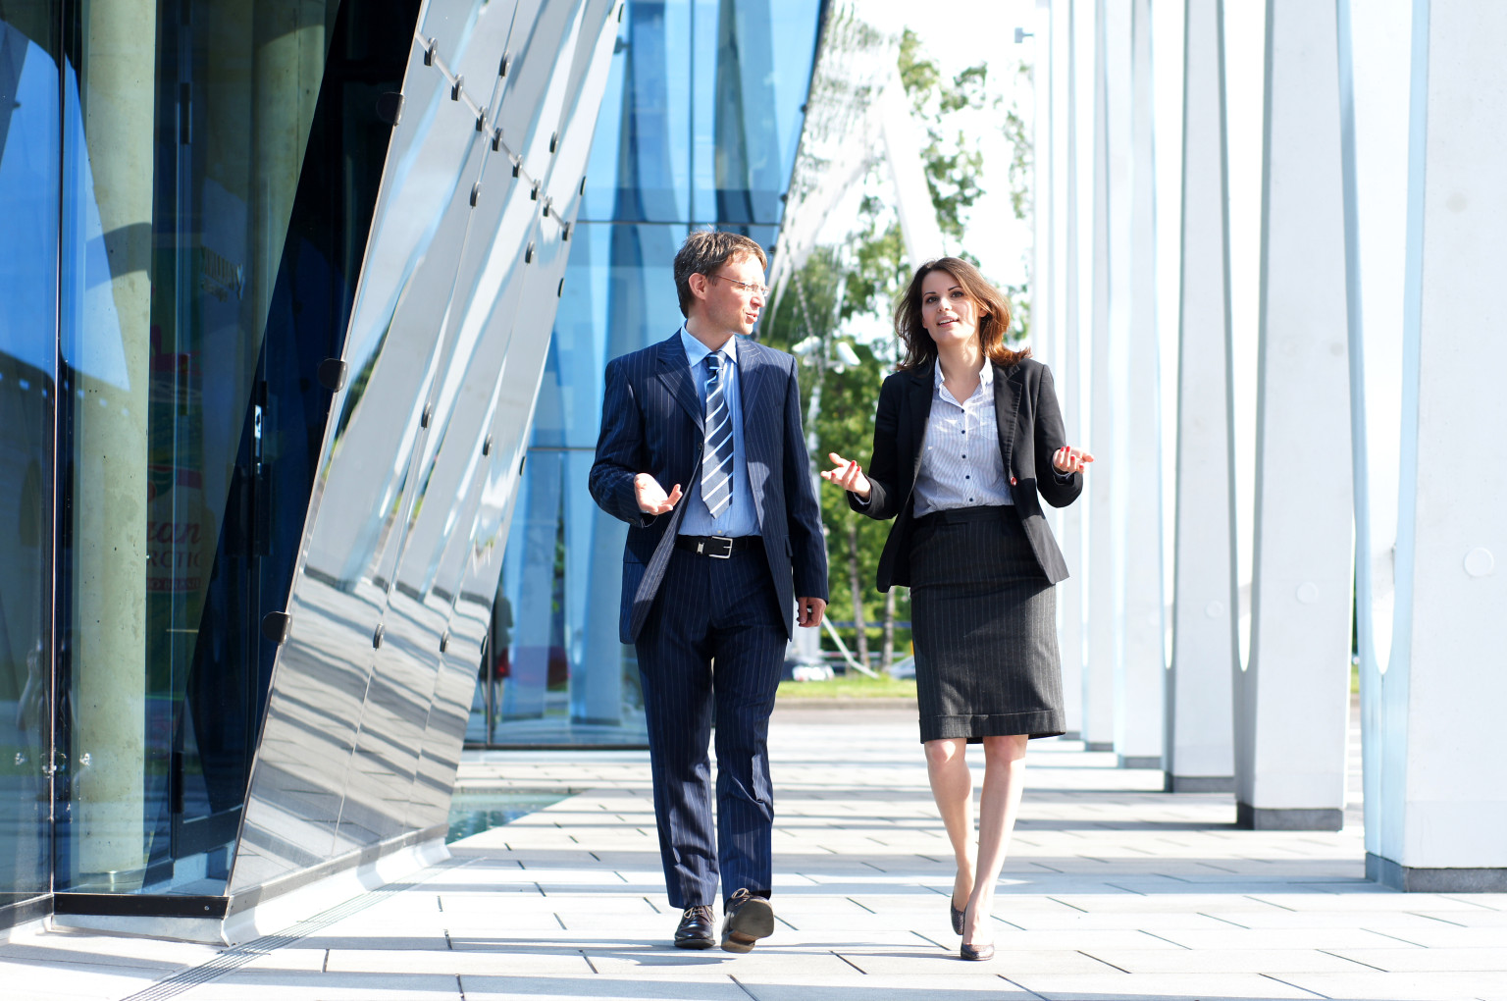
“
“I always prefer direct communication with hearing people. If technology or interpreters are involved, there is always a distance between me and the other person. It diminishes the quality of the human connection.”
”
- P11

Slide 54
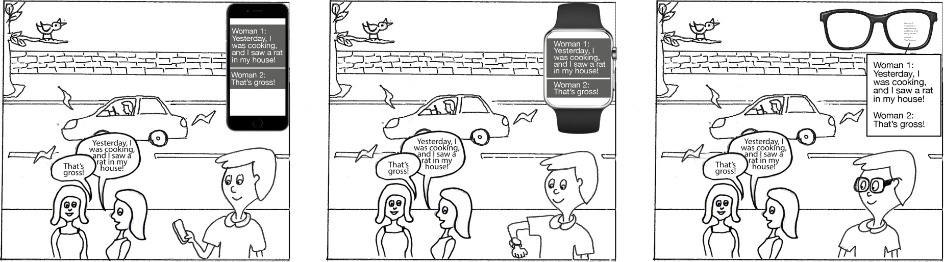
Comparing Devices
STUDY 1 PART 2: TECHNOLOGY
Smartphone Smartwatch HMD

Slide 55
STUDY 1 PART 2: TECHNOLOGY
 | HMD | Smartphone | Smartwatch
Walking | N=11 | N=1
Transit (bus, car) | N=6 | N=4 | N=1
Recreational | N=5 | N=4

Slide 56
STUDY 1 PART 2: TECHNOLOGY
HMD was most preferred because it would reduce the visual attention split.
 | HMD | Smartphone | Smartwatch
Walking | N=11 | N=1
Transit (bus, car) | N=6 | N=4 | N=1
Recreational | N=5 | N=4

Slide 57
STUDY 1 PART 2: TECHNOLOGY
 | HMD | Smartphone | Smartwatch
Walking | N=11 | N=1
Transit (bus, car) | N=6 | N=4 | N=1
Recreational | N=5 | N=4
For high-contact sports, some people wanted smartphone because HMD could fall off.

Slide 58
STUDY 1 PART 2: TECHNOLOGY
Smartwatch was the least preferred because of the small display size.
 | HMD | Smartphone | Smartwatch
Walking | N=11 | N=1
Transit (bus, car) | N=6 | N=4 | N=1
Recreational | N=5 | N=4

Slide 59
STUDY 1 PART 2: TECHNOLOGY
Designs Sketched By Participants

Slide 60
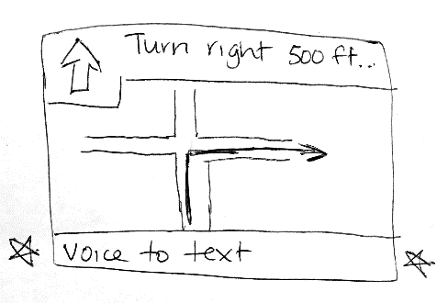
STUDY 1 PART 2: TECHNOLOGY
Designs Sketched By Participants
P5: Integrate captioning with car GPS
To reduce having to look at multiple devices

Slide 61
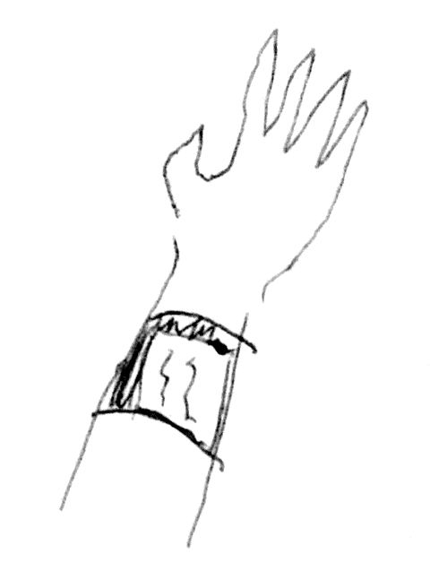
STUDY 1 PART 2: TECHNOLOGY
Designs Sketched By Participants
P5: Integrate captioning with car GPS
To reduce having to look at multiple devices
P2: A wrist worn device
To display captions

Slide 62
Background and Past Work
Study 1:
Interview
Proof-of-Concept HMD Prototype
Study 2: Evaluation

Slide 63
Background and Past Work
Study 1:
Interview
Proof-of-Concept HMD Prototype
Study 2: Evaluation

Slide 64
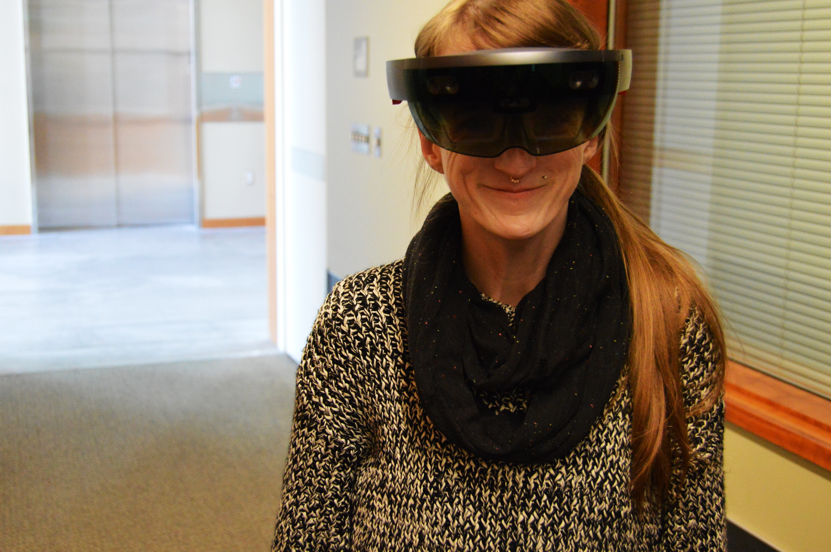
PROOF OF CONCEPT
“This is third floor of the building.
We have a shop here…”

Slide 65
PROOF OF CONCEPT
“This is third floor of the building.
We have a shop here.
Below, there’s a restroom. ” `

Slide 66
PROOF OF CONCEPT
“This is third floor of
the building. We
have a shop here. ”
“This is third floor of the building.
We have a shop here…”
“This is third floor of the building.
We have a shop here.
Below, there’s a restroom. ”

Slide 67
PROOF OF CONCEPT
“This is third floor of
the building. We
have a shop here. ”
“This is third floor of
the building. We
have a shop here. ”
“This is third floor of the building.
We have a shop here…”
“This is third floor of the building.
We have a shop here.
Below, there’s a restroom. ”

Slide 68
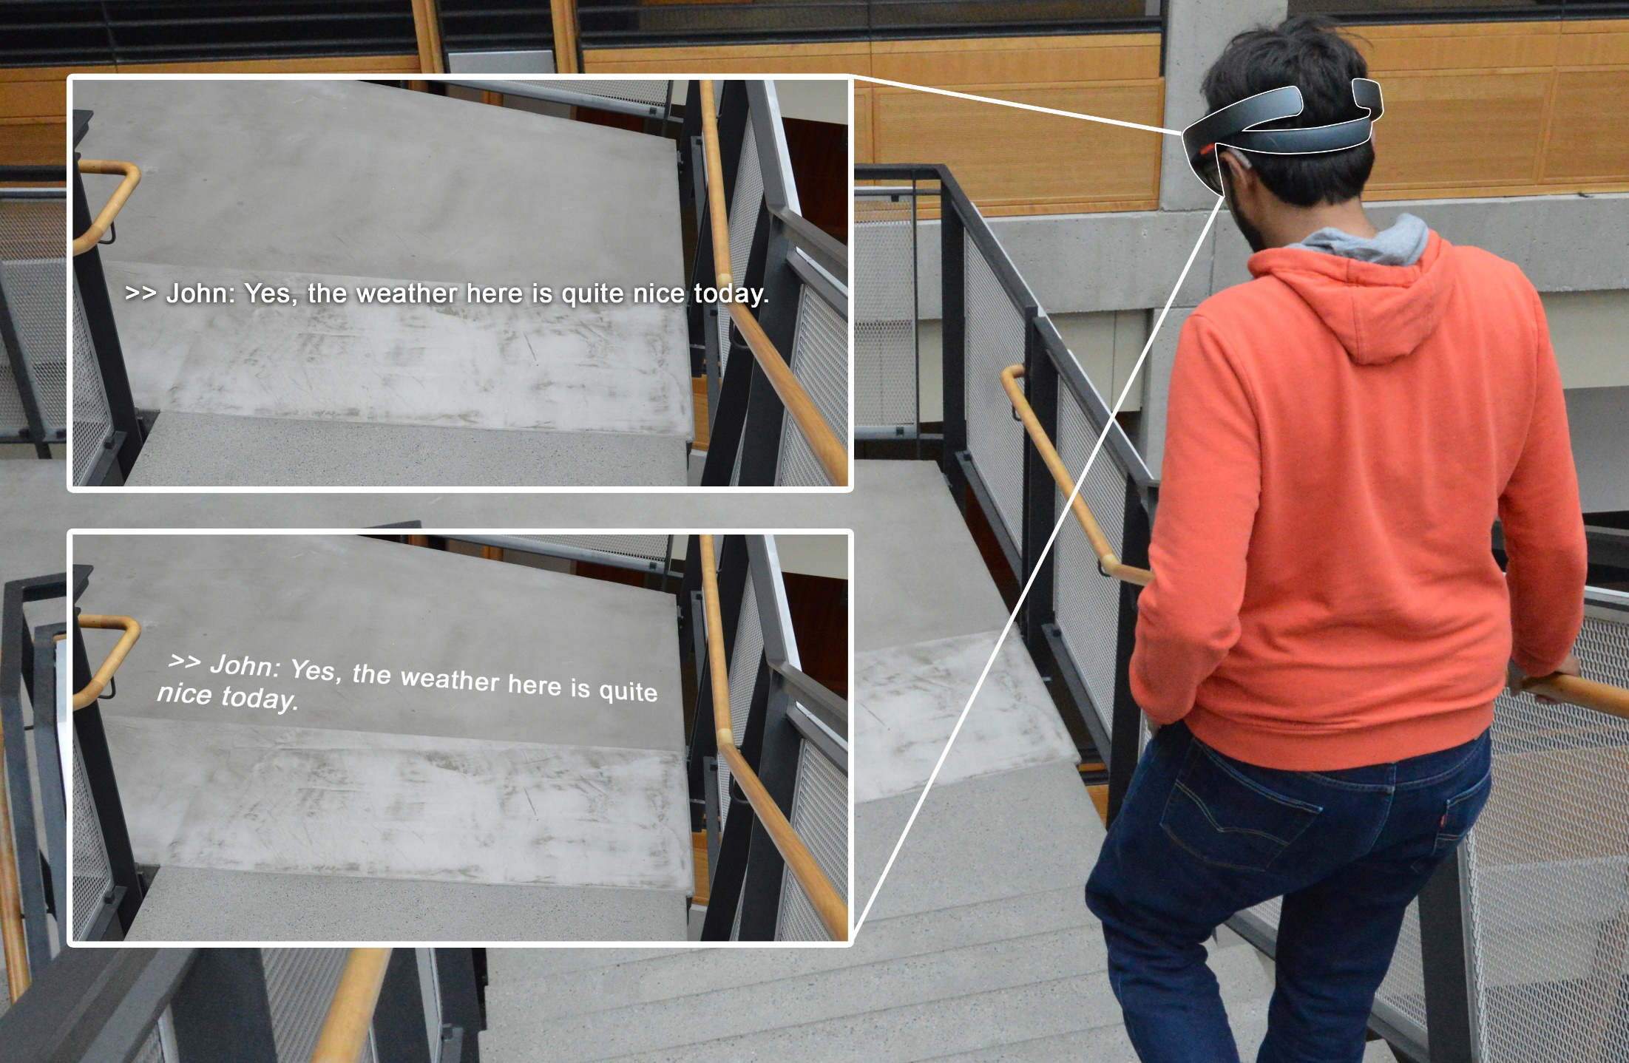
Design 1: Captions at a fixed distance from the eyes
Design 2: Captions projected onto a surface

Slide 69
Background and Past Work
Study 1:
Interview
Proof-of-Concept HMD Prototype
Study 2: Evaluation

Slide 70
Background and Past Work
Study 1:
Interview
Proof-of-Concept HMD Prototype
Study 2: Evaluation

Slide 71
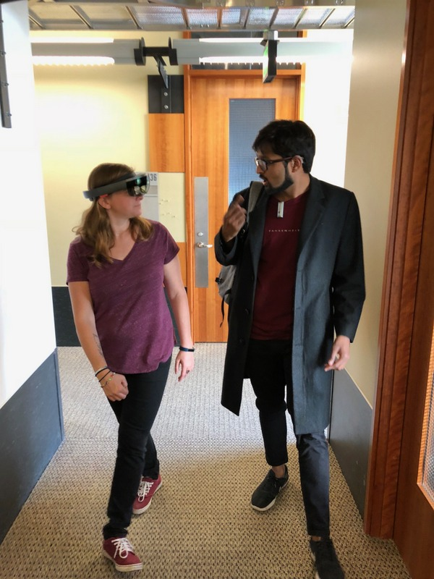
Study 2

Slide 72
Study 2
Primary Goal
To assess whether the use of HMD captions increased conversation accessibility, and decreased attention split for walking conversations

Slide 73
Study 2
Primary Goal
To assess whether the use of HMD captions increased conversation accessibility, and decreased attention split for walking conversations
Participants
10 DHH individuals; 6 from Study 1

Slide 74
Study 2
Primary Goal
To assess whether the use of HMD captions increased conversation accessibility, and decreased attention split for walking conversations
Participants
10 DHH individuals; 6 from Study 1
Part 1: Walking Scenario with HMD
One researcher conversed with the participant on casual topics
Another researcher took observational notes
The first researcher wore a lapel microphone that relayed speech to the on-site transcriber
Part 2: Open-ended Interview
On the experience any feedback to the prototype

Slide 75
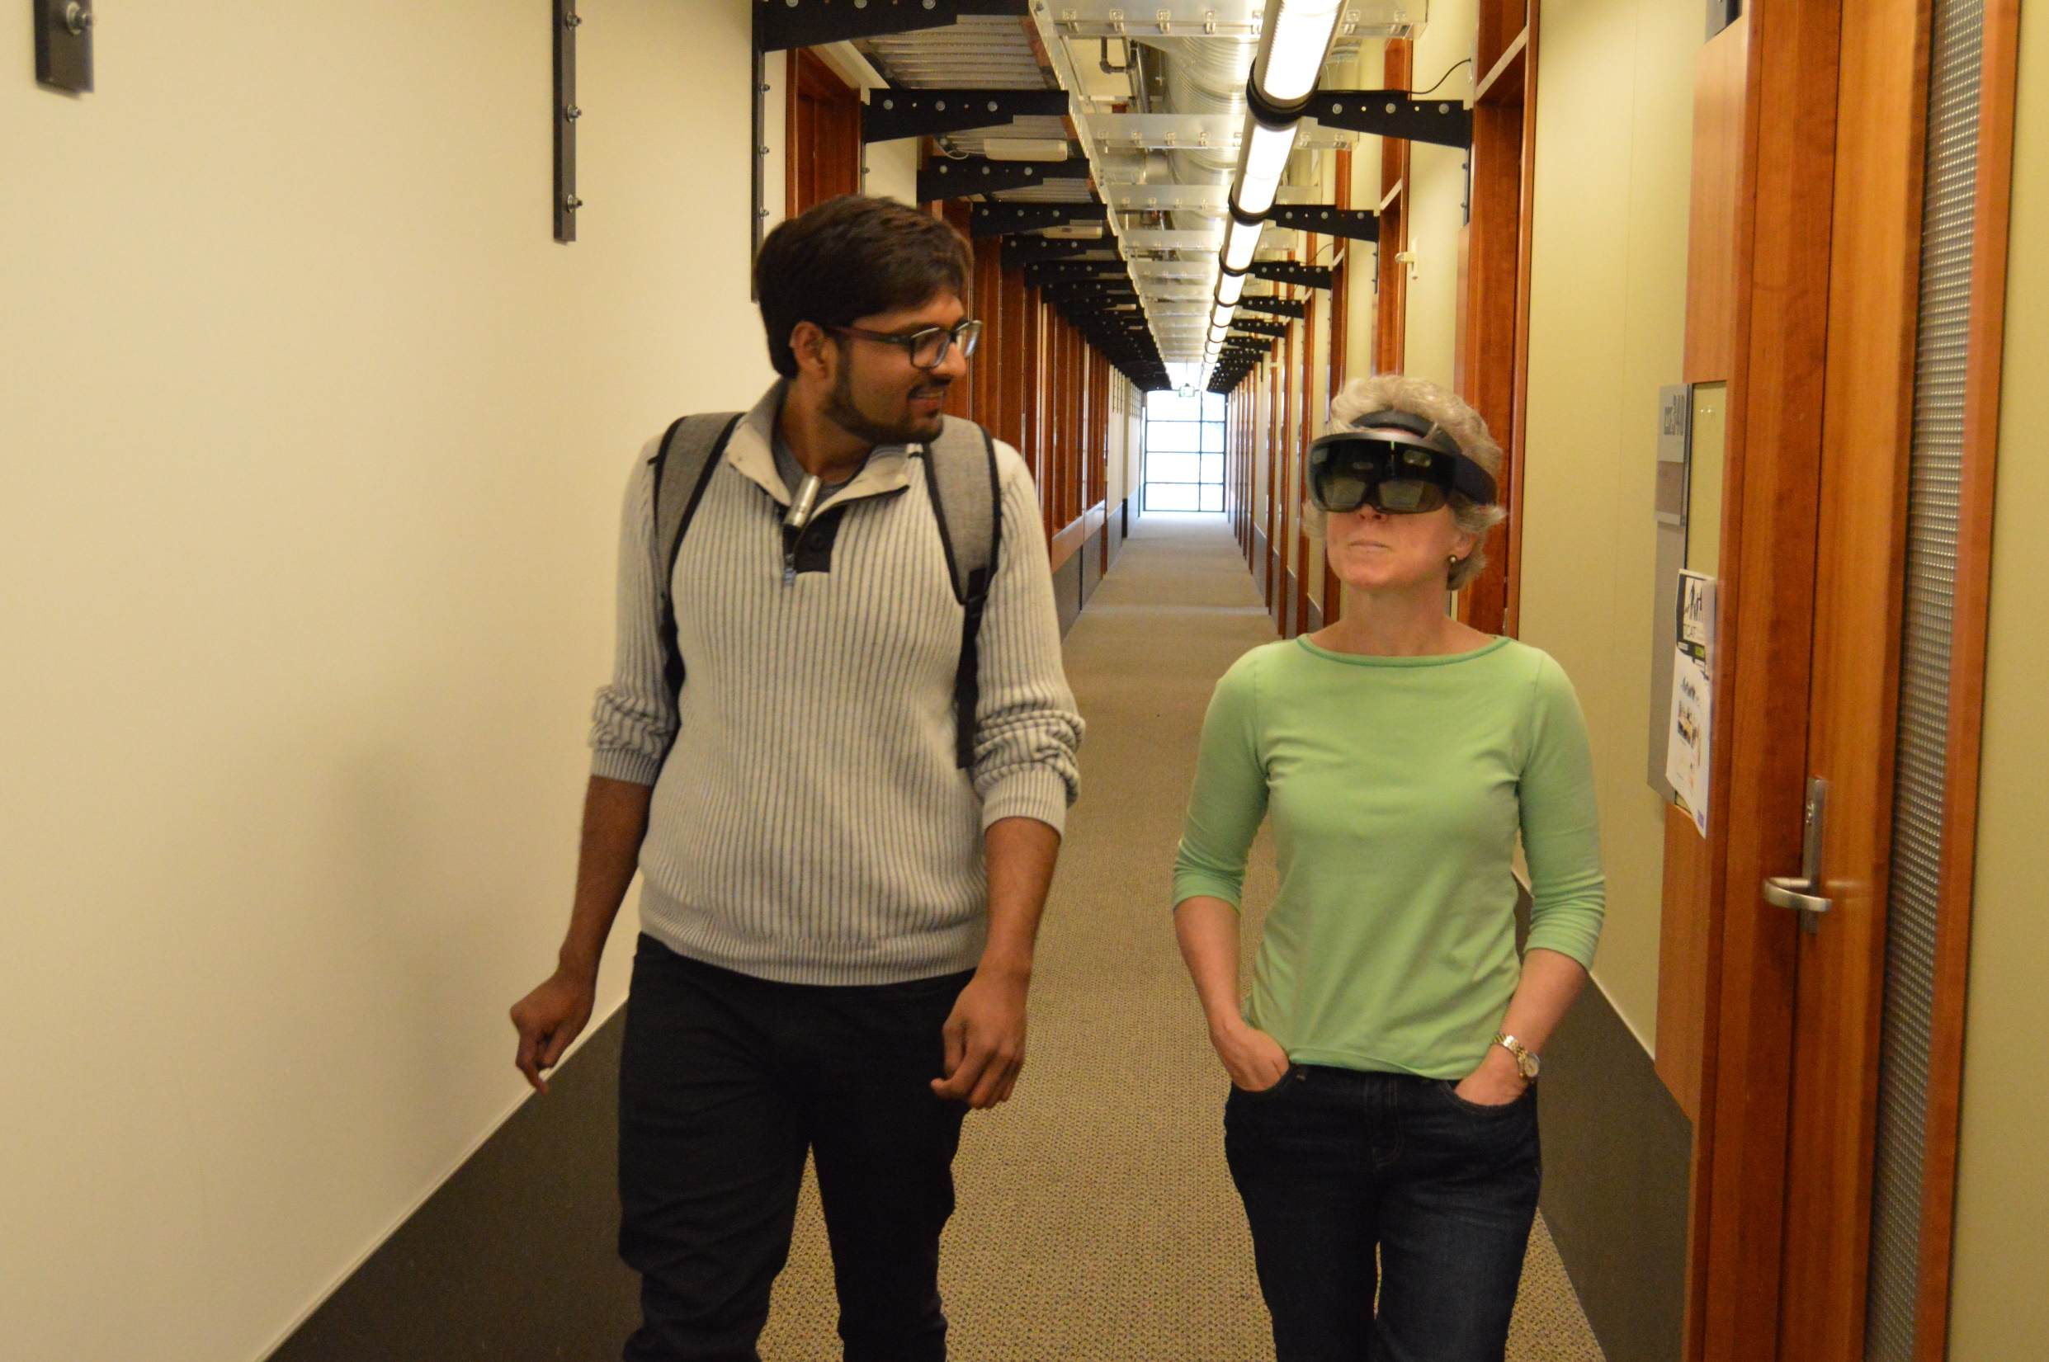
All participants used our prototype to understand at least
some part of the conversation while walking.
STUDY 2: RESULTS

Slide 76
`
“
“With this, you can look where you want and still follow along with the conversation.”
”
- R4

Slide 77
However, four participants found captions to be occasionally distracting.
STUDY 2: RESULTS

Slide 78
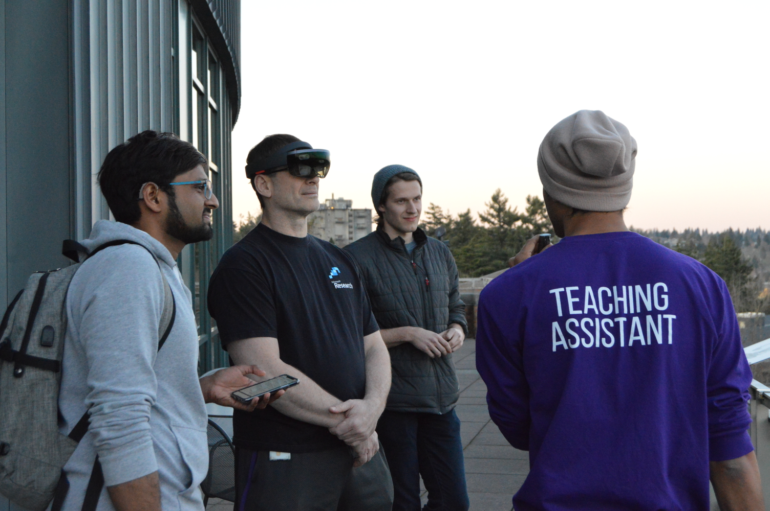
“
When I was trying to formulate my own responses, I would find the captions quite distracting and, in cases like that, I wish […] that I could look away from [the captions], at my discretion.
”
- R5

Slide 79
STUDY 2: RESULTS
High-Level Themes

Slide 80
STUDY 2: RESULTS
High-Level Themes

Slide 81
STUDY 2: RESULTS
High-Level Themes
Visual Split
Participants used both speechreading and captions.
Oral speakers looked at speakers more than captions. Sign language users focused on captions more.

Slide 82
STUDY 2: RESULTS
High-Level Themes
Visual Split
Participants used both speechreading and captions.
Oral speakers looked at speakers more than captions. Sign language users focused on captions more.
Caption Placement
Split between whether to show captions in the field of view (N=6) or above speakers (N=4).
All wanted the ability to turn off the captions when needed.

Slide 83
STUDY 2: RESULTS
High-Level Themes
Visual Split
Participants used both speechreading and captions.
Oral speakers looked at speakers more than captions. Sign language users focused on captions more.
Caption Placement
Split between whether to show captions in the field of view (N=6) or above speakers (N=4).
All wanted the ability to turn off the captions when needed.
Design Suggestions
Display speaker identification cues (e.g., name, location).
Display environmental sounds (e.g., door opening).
Display voice tone and volume.

Slide 84
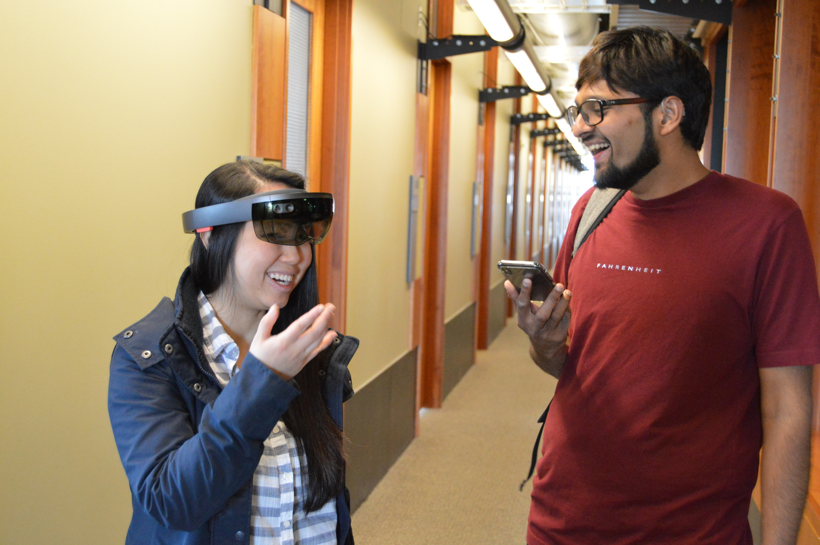
Reflection

Slide 85
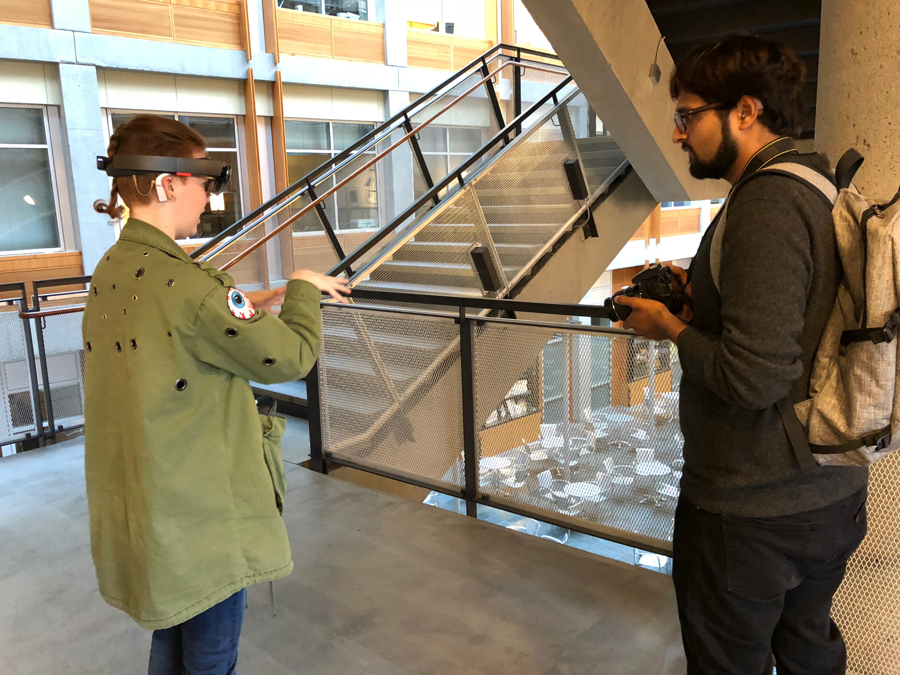
As the first work to explore communication challenges and technology
design for DHH people in mobile context, we have shown that:

Slide 86
  Mobile context offer new challenges and a new unexplored space for innovation.
1

Slide 87
  Mobile context offer new challenges and a new unexplored space for innovation.
  Assistive technology in mobile contexts need to be carefully designed.
1
2

Slide 88
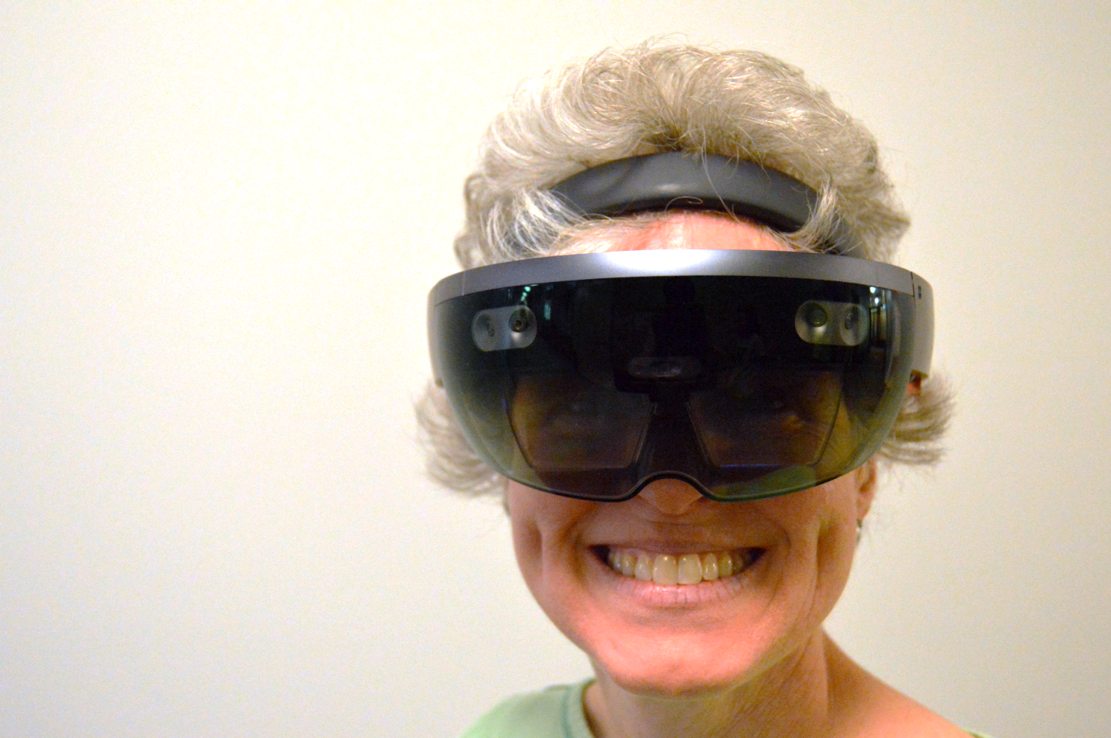
Design Guidelines for HMD-Captioning

Slide 89
Design Guidelines for HMD-Captioning
Automatic depth alignment

Slide 90
Design Guidelines for HMD-Captioning
Automatic depth alignment
Adapt to changing context

Slide 91
Design Guidelines for HMD-Captioning
Automatic depth alignment
Adapt to changing context
Convey contextual information

Slide 92
Design Guidelines for HMD-Captioning
Automatic depth alignment
Adapt to changing context
Convey contextual information
Customizable

Slide 93
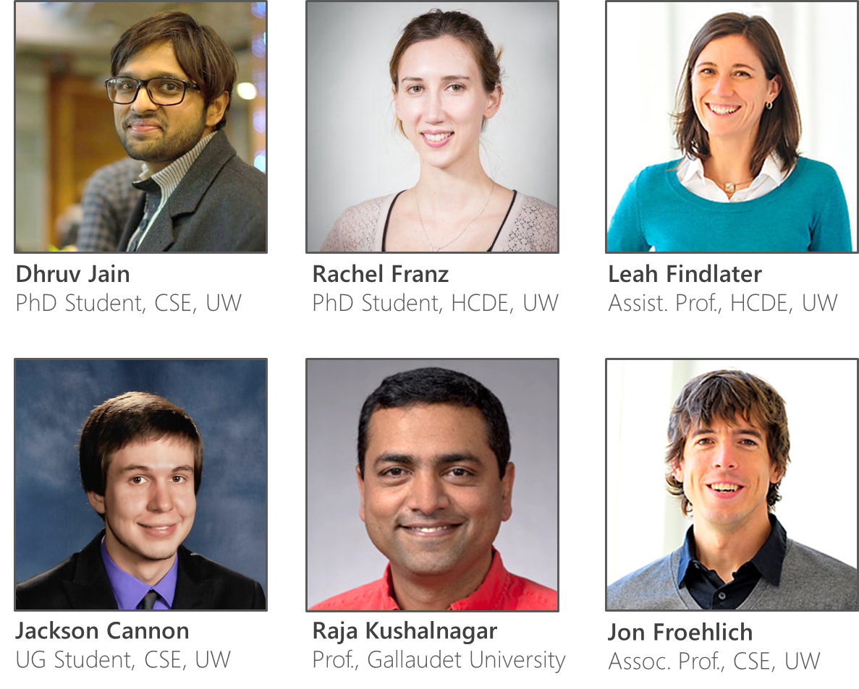
The Team
djain@uw.edu
franzrac@uw.edu
leahkf@uw.edu
jackscan@uw.edu
raja.kushalnagar@gallaudet.edu
jonf@uw.edu

Slide 94




Towards Accessible Conversations in a Mobile Context for People who are Deaf or Hard of Hearing
The Team
djain@uw.edu
franzrac@uw.edu
leahkf@uw.edu
jackscan@uw.edu
raja.kushalnagar@gallaudet.edu
jonf@uw.edu
Sponsors
UW
Reality Lab

